Slide 1
Injury Scenarios Only
A Safety & Health Curriculum for Young Workers
California Edition
DEPARTMENT OF HEALTH AND HUMAN SERVICES
Centers for Disease Control and Prevention
National Institute for Occupational Safety and Health

Slide 2
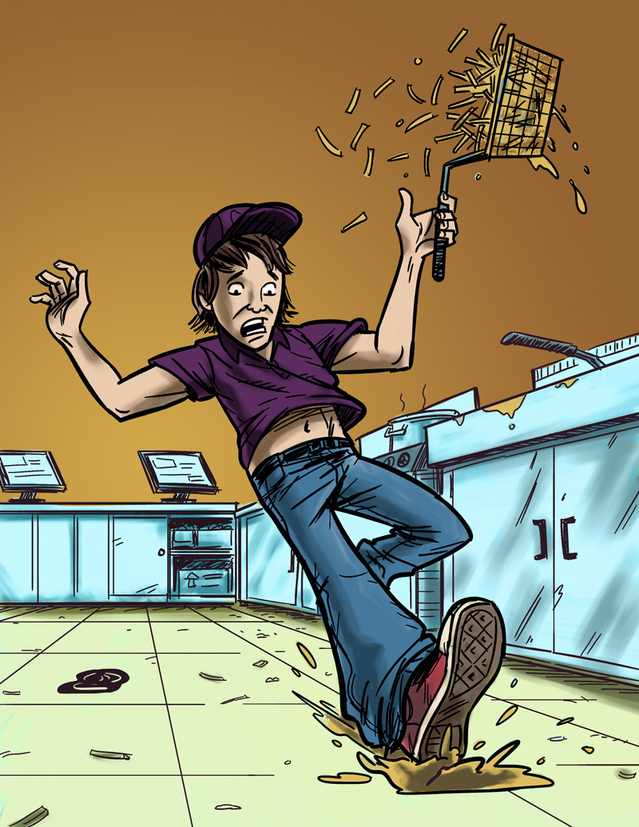
Eliminating or Reducing Hazards
Jack’s Story
Job: Fast food worker
Hazard: Greasy, slippery floors
Injury: Injured tailbone

Slide 3
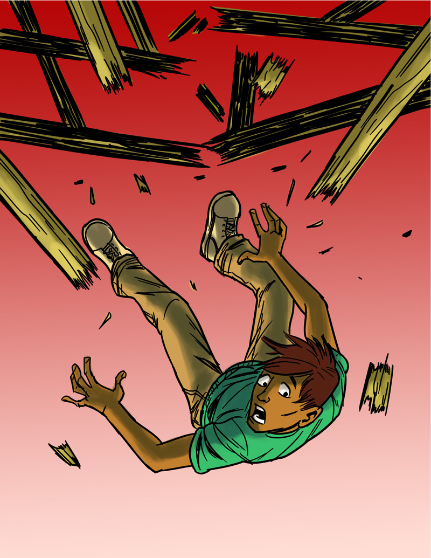
Eliminating or Reducing Hazards
Antonio’s Story
Job: Construction helper
Hazard: Unguarded chimney hole (on an unfinished roof)
Injury: Broken back

Slide 4
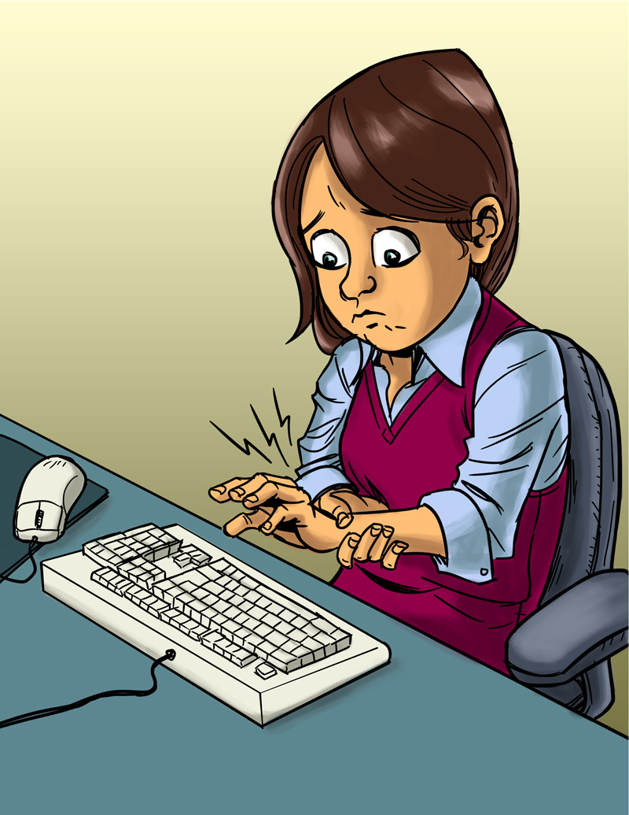
Eliminating or Reducing Hazards
Angela’s Story
Job: Office worker
Hazard: Excessive typing in an awkward position
Injury: Repetitive stress injury

Slide 5
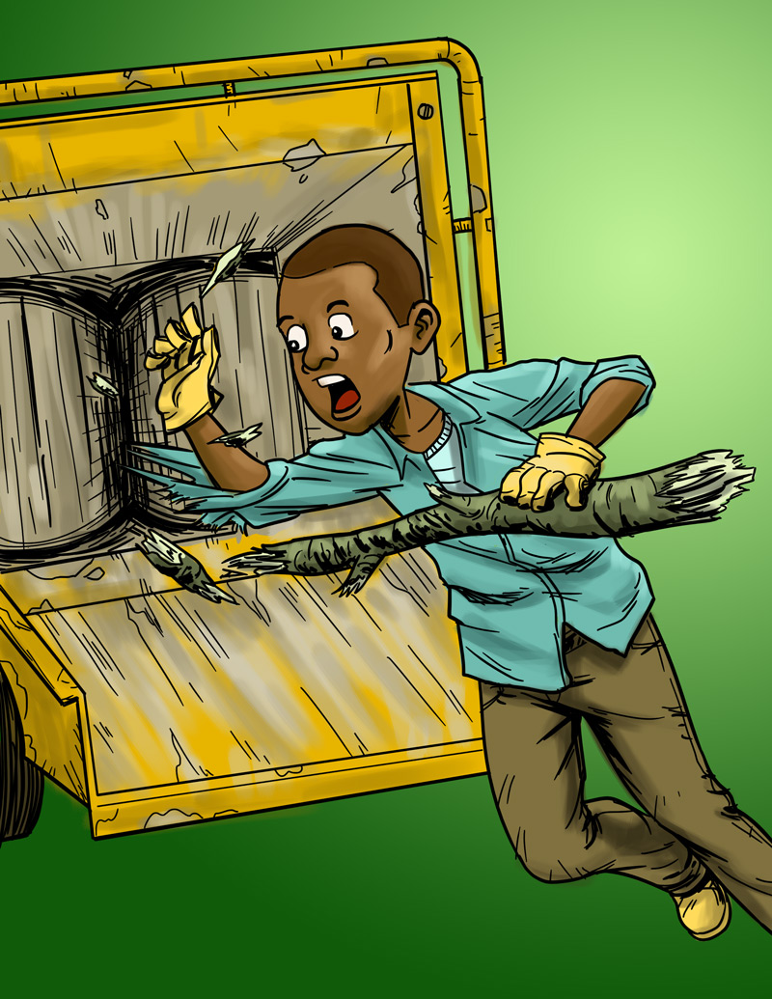
Eliminating or Reducing Hazards
Terrell’s Story
Job: Landscape worker
Hazard: Wood chipper
Injury: Death

Slide 6
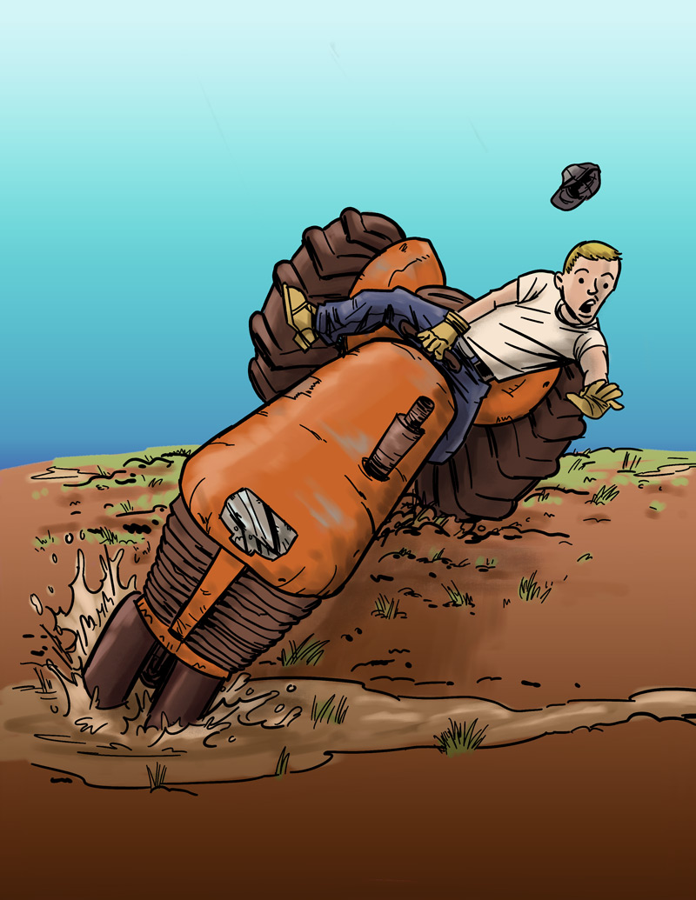
Eliminating or Reducing Hazards
Cody’s Story
Job: Farm worker
Hazard: Tractor without roll bar
Injury: Legs crushed under tractor

Slide 7
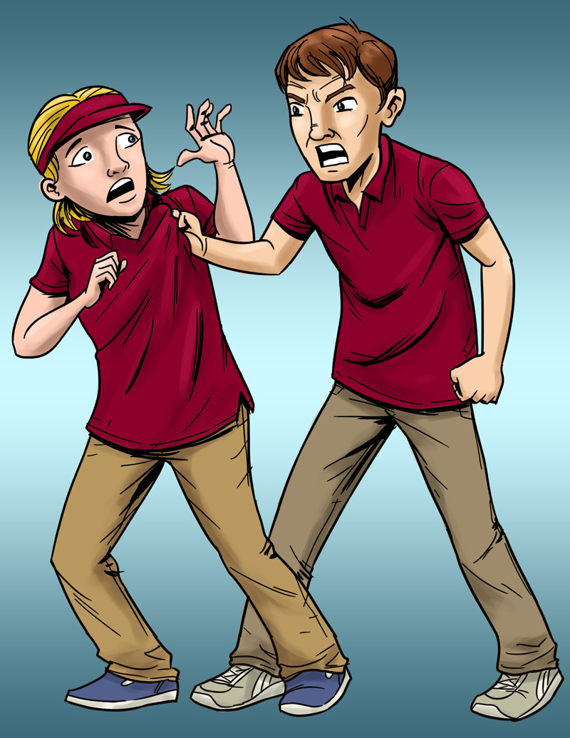
Eliminating or Reducing Hazards
Lindsey’s Story
Job: Pizza shop cashier
Hazard: Violence (by a co-worker)
Injury: Bumps and bruises caused by abusive co-worker

Slide 8
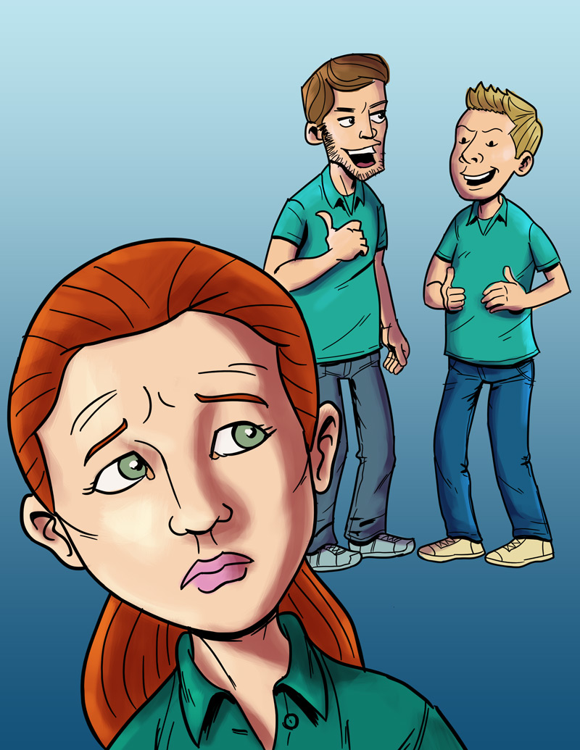
Eliminating or Reducing Hazards
Anna’s Story
Job: Smoothie shop worker
Hazard: Sexual harassment
Injury: Emotional trauma

Slide 9
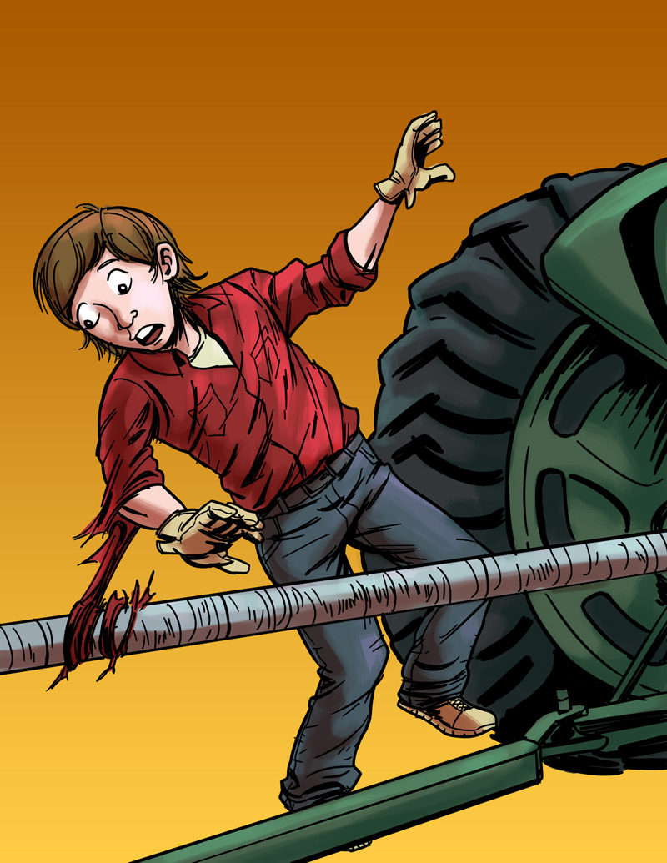
Eliminating or Reducing Hazards
Logan’s Story
Job: Farm worker
Hazard: Unguarded, rotating bar on a tractor
Injury: Severed arm, broken neck

Slide 10
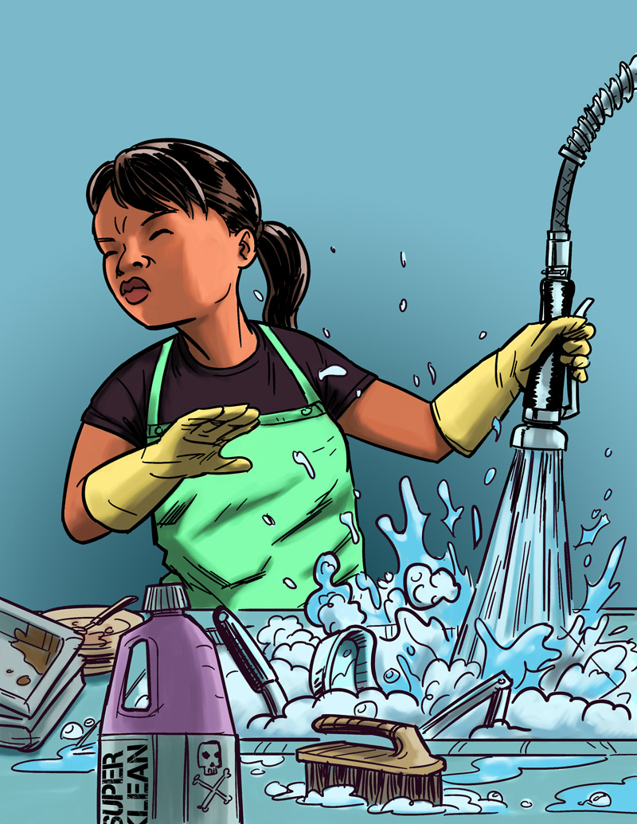
Eliminating or Reducing Hazards
Jasmin’s Story
Job: Hospital dishwasher
Hazard: Chemical dishwashing solution
Injury: Chemical burn to the eye

Slide 11
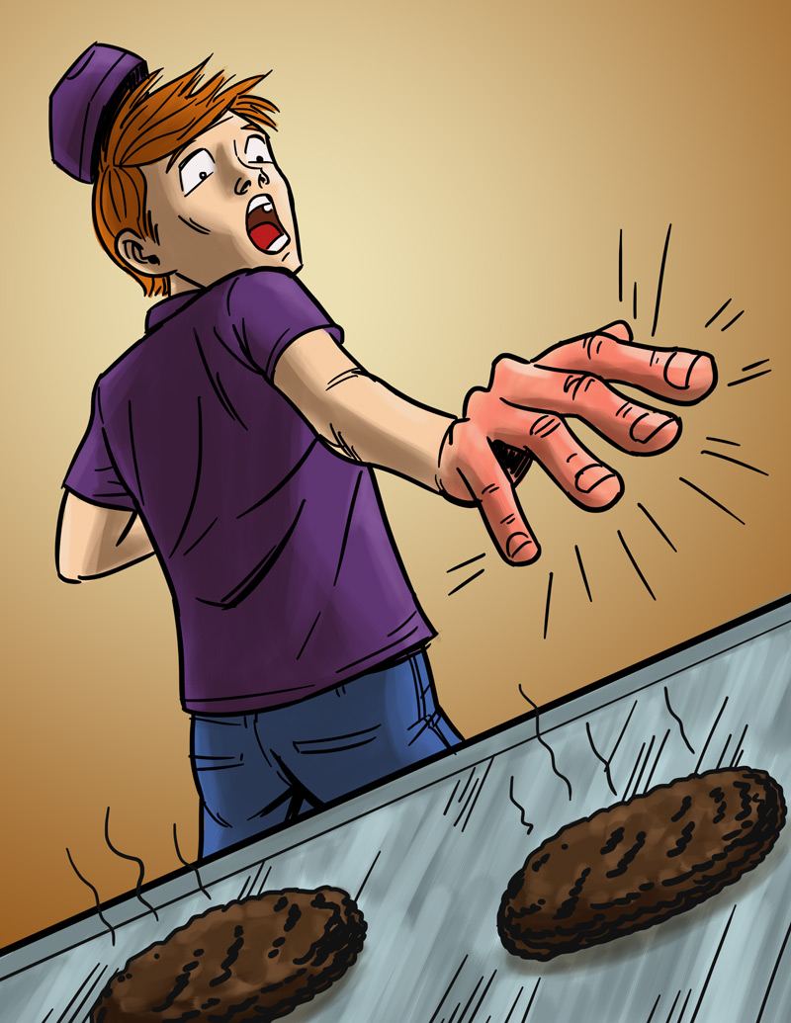
Eliminating or Reducing Hazards
Will’s Story
Job: Fast food worker
Hazard: Hot grill
Injury: Burned hand

Slide 12
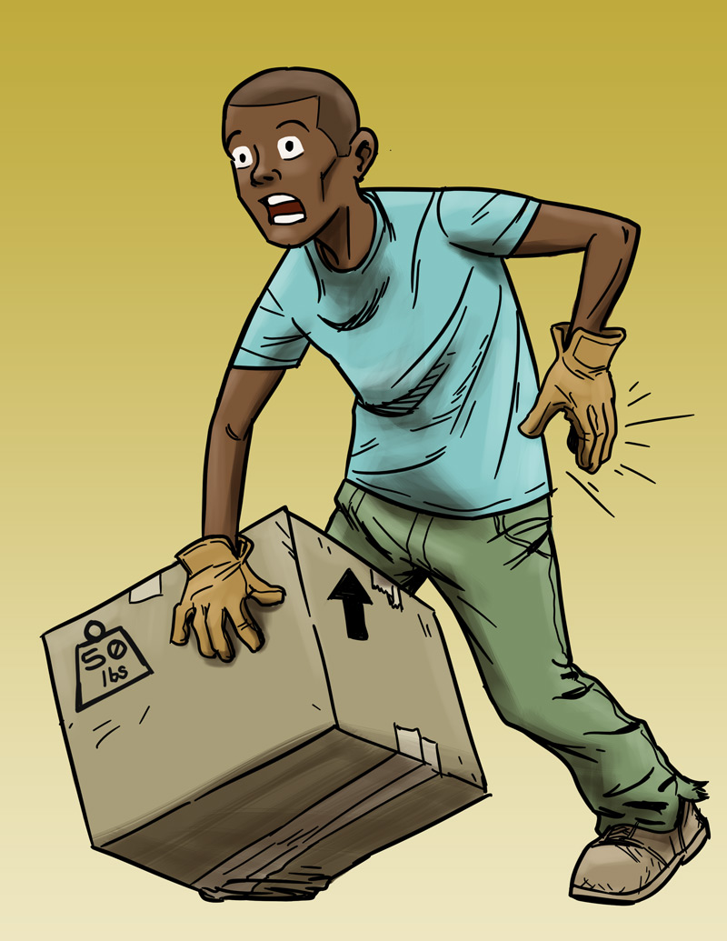
Eliminating or Reducing Hazards
Andre’s Story
Job: Grocery store clerk
Hazard: Lifting heavy boxes
Injury: Back strain

Slide 13
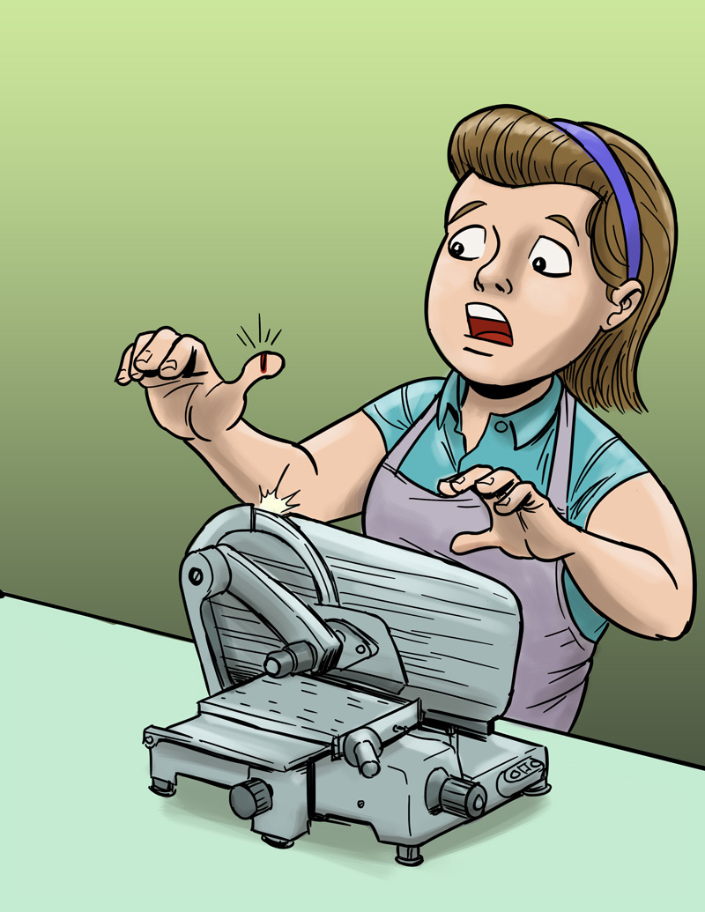
Eliminating or Reducing Hazards
Molly’s Story
Job: Grocery store deli clerk
Hazard: Meat slicer
Injury: Cut finger

Slide 14
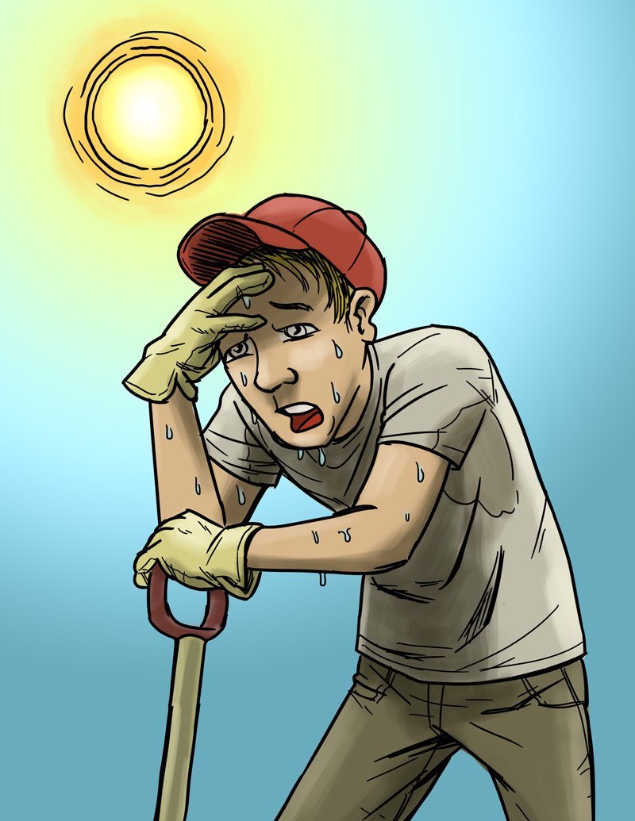
Eliminating or Reducing Hazards
Chris’s Story
Job: City public works employee
Hazard: Excessive heat
Injury: Heat stroke

Slide 15
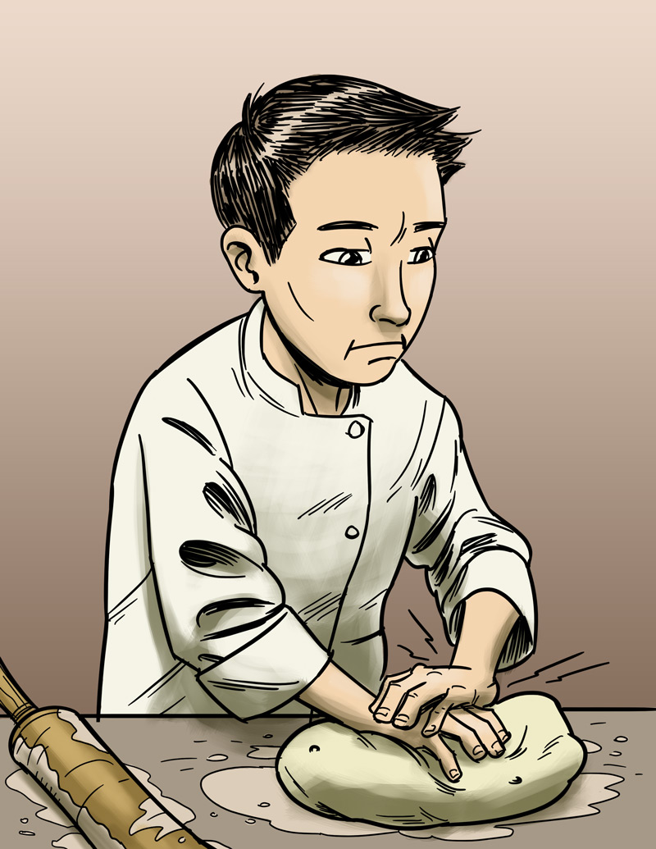
Eliminating or Reducing Hazards
James’s Story
Job: Pizza shop employee
Hazard: Repetitive motion
Injury: Hand, back injury

Slide 16
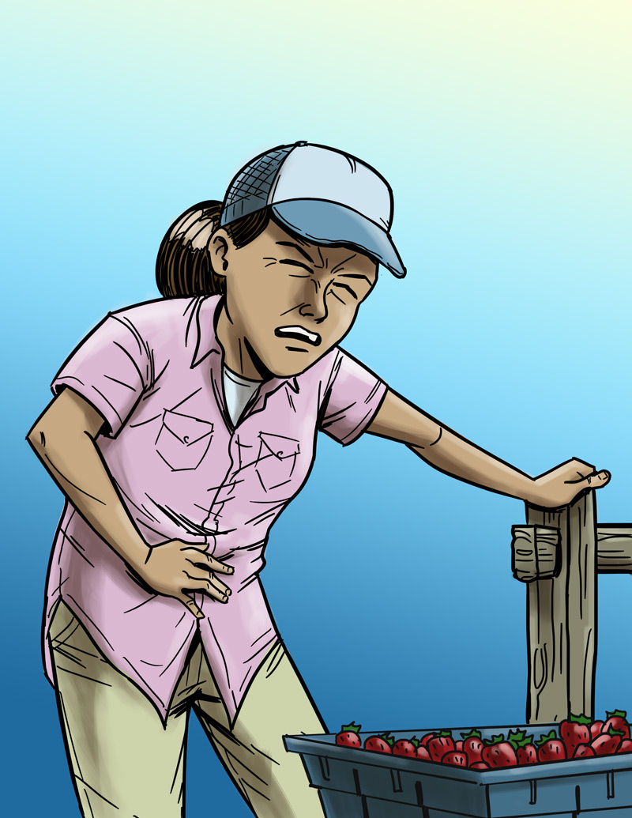
Eliminating or Reducing Hazards
Maria’s Story
Job: Farm worker
Hazard: Pesticide/chemical exposure
Injury: Illness due to poisoning

Slide 17
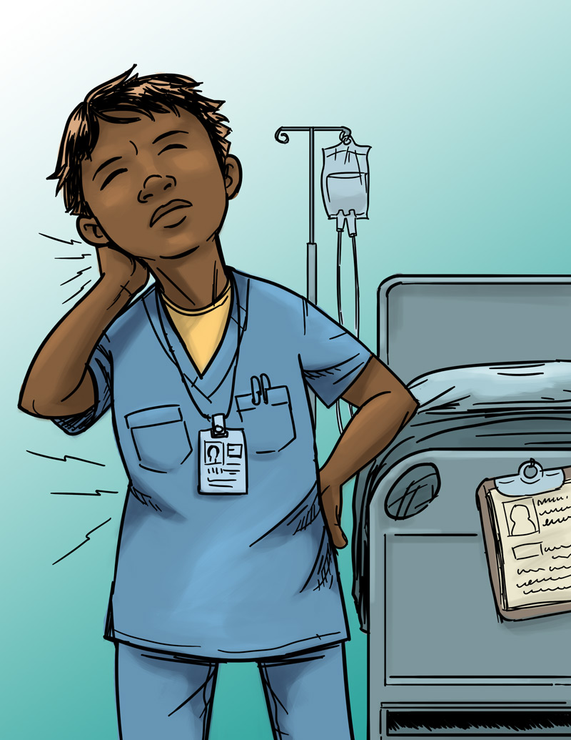
Eliminating or Reducing Hazards
Jada’s Story
Job: Nursing aide
Hazard: Heavy lifting
Injury: Back, neck, and shoulder pain

Slide 18
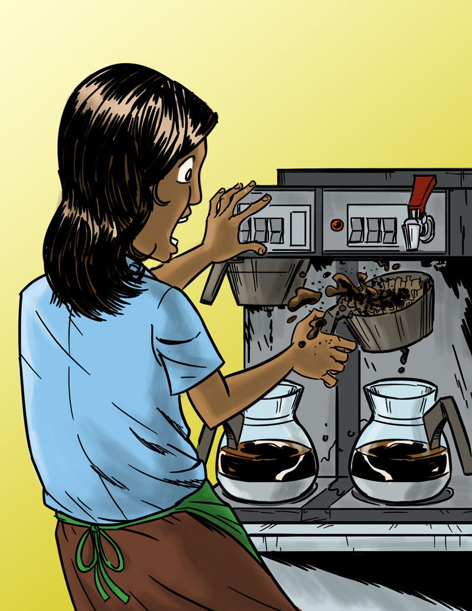
Eliminating or Reducing Hazards
Anita’s Story
Job: Barista
Hazard: Hot liquids
Injury: Burn

