Slide 1
Problem-Solving for Safety

Slide 2
Acknowledgements
Portions of these training activities are adapted from:
The OSHA’s 11 curriculum, http://youngworkers.org/our-materials/teachers/#osha8217s-11-curriculum-2009
Youth @ Work—Talking Safety, National Institute for Occupational Safety and Health, https://www.cdc.gov/niosh/talkingsafety/
Training Materials from the Worker Occupational Safety and Health Training and Education Program (WOSHTEP), administered by the Commission on Health and Safety and Workers’ Compensation in the Department of Industrial Relations, https://www.dir.ca.gov/chswc/woshtep.html
Funded by the California Department of Public Health Occupational Health Branch
through a grant from the Centers for Disease Control and Prevention (Grant# 1 NB01OT009226-01-00). Its contents are solely the responsibility of the authors and do not necessarily represent the official views of the Centers for Disease Control and Prevention or the Department of Health and Human Services.

Slide 3
What you’ll learn
Discuss: Underlying Causes of Workplace Injuries
Review: Rights on the Job
Understanding Hazard Control
Practice: Job Hazard Analysis
Communicating about Safety on the Job

Slide 4
Agree or Disagree?
“Most injuries and illnesses on the job happen because workers make mistakes or are careless.”

Slide 5
Accidents in the News
“He must have fallen in the hole. That's the only thing that makes sense. He knew not to go in there. He knew to stay two feet back. Those are the rules.“
– Employer commenting on employee death in a trench while replacing a sewer line.

Slide 6
Direct and Underlying Causes of Injuries and Illnesses
Direct Cause
(“unsafe act” or technical failure)

Slide 7
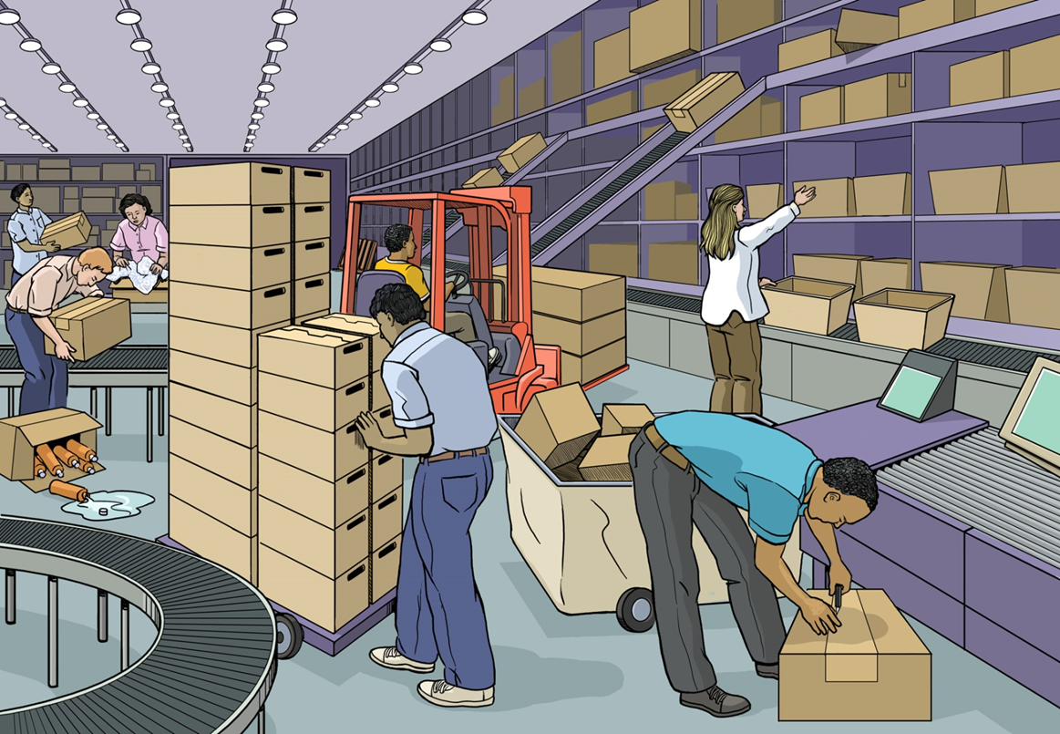
Tom’s Story

Slide 8
Cal/OSHA Standards
General Cal/OSHA standards:
Injury and Illness Prevention Program standard
Hazard Communication standard
Access to Employee Exposure and Medical Records standard
Log of Work-Related Injuries and Illnesses (Cal/OSHA Form 300).
Specific Cal/OSHA standards:
Provide protection against specific hazards.
Set out detailed rules that must be followed or minimum levels of protection that must be achieved.
Cover a wide range of hazards, from toxic substances to specific operations such as roofing.

Slide 9
Cal/OSHA’s IIPP Standard
Management commitment
Incident investigations
Hazard identification
Hazard control
Training of employees, supervisors, managers
Communication with employees about health and safety
Fair system for compliance with safety rules
The IIPP must be written and implemented

Slide 10
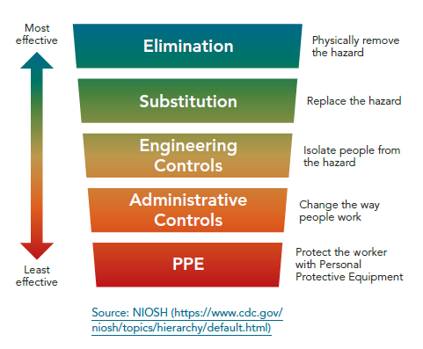
Understanding the “hierarchy of controls”

Slide 12
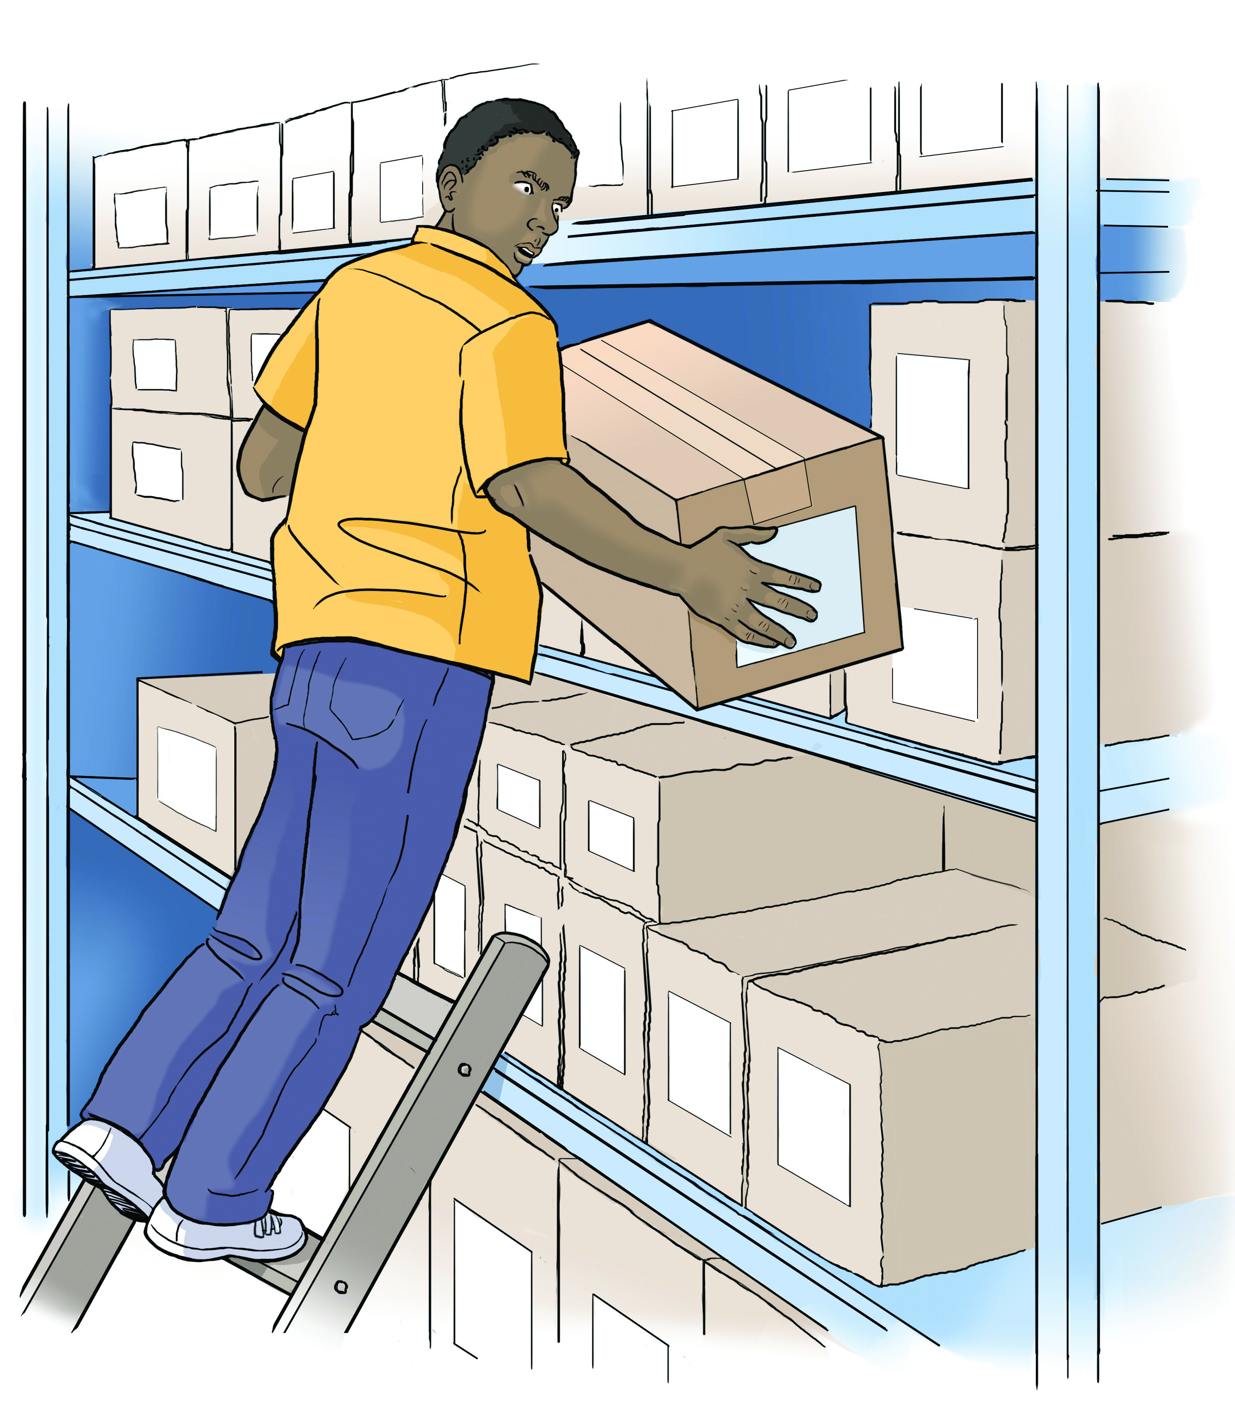
David’s Story
Job: Stocking shelves
Injury: Broken leg due to fall
from ladder

Slide 13
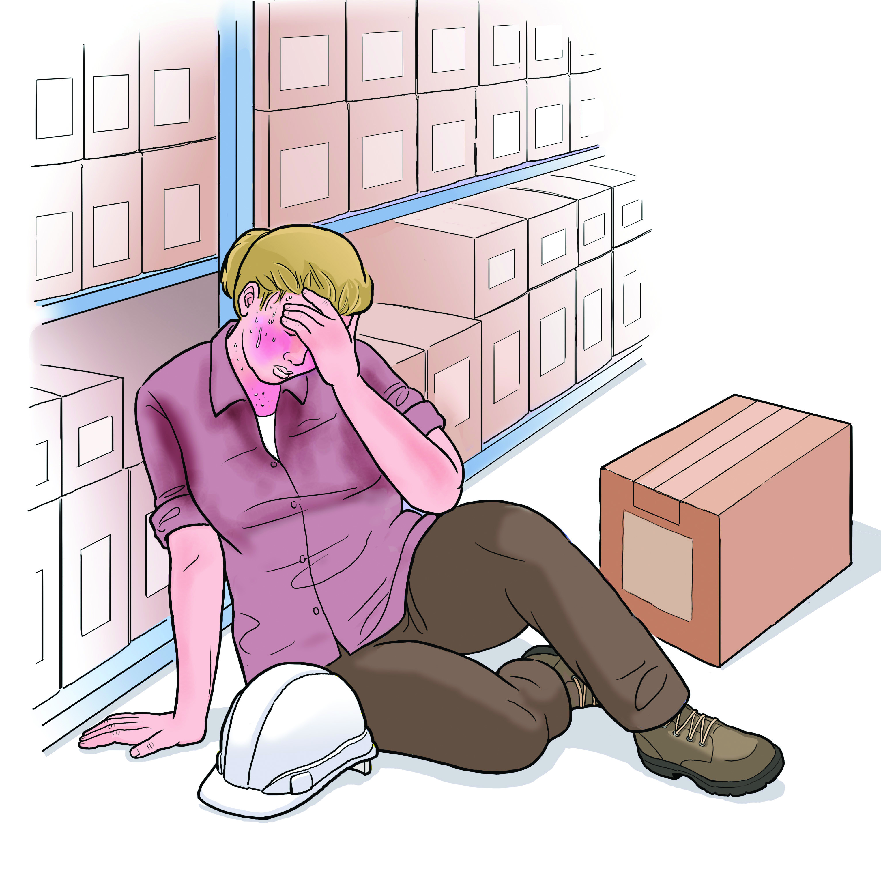
Jenna’s Story
Job: Warehouse stocker
Injury: Killed by indoor heat exposure

Slide 14
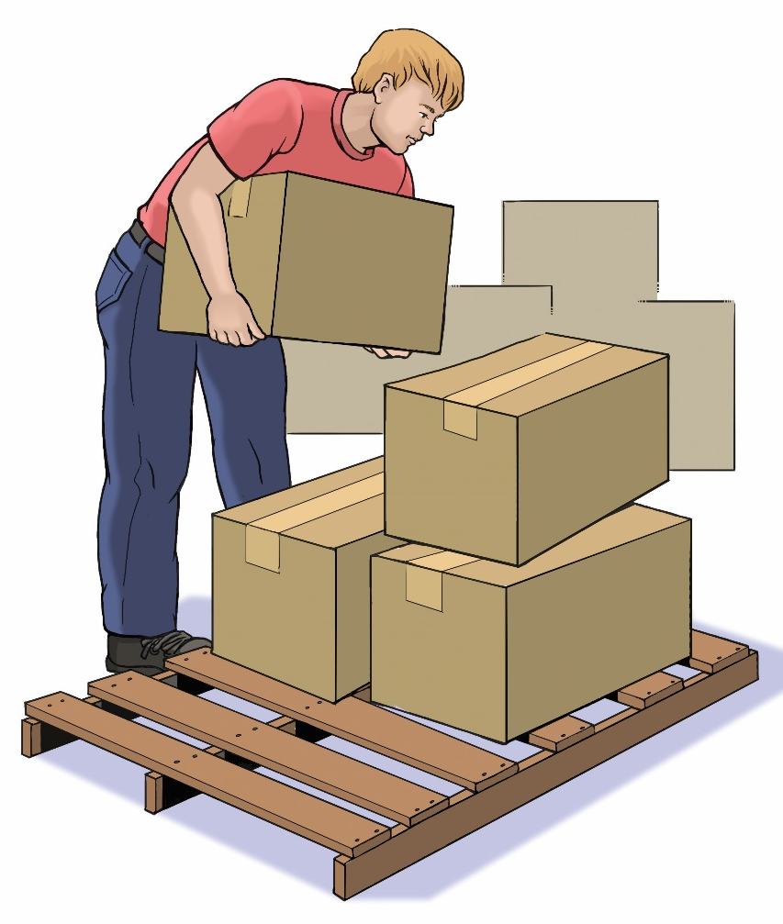
Stephen’s Story
Job: Warehouse worker
Injury: Hurt back while loading boxes

Slide 15
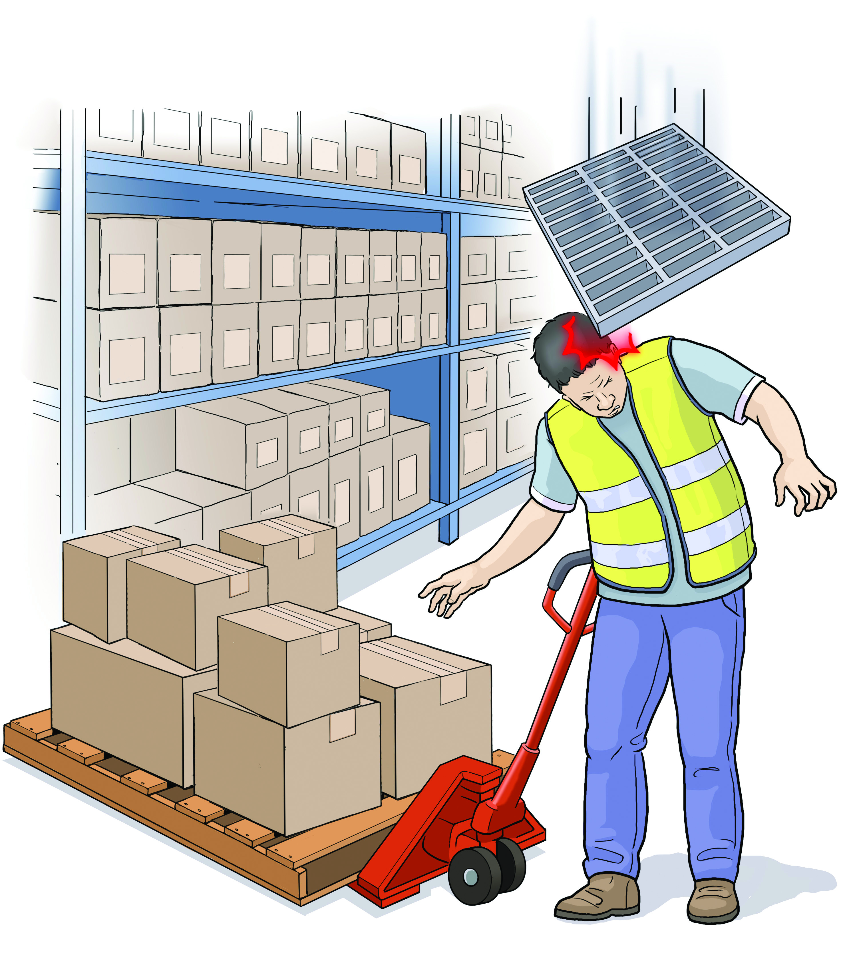
Joe’s Story
Job: Warehouse worker
Injury: Struck by falling object

Slide 16
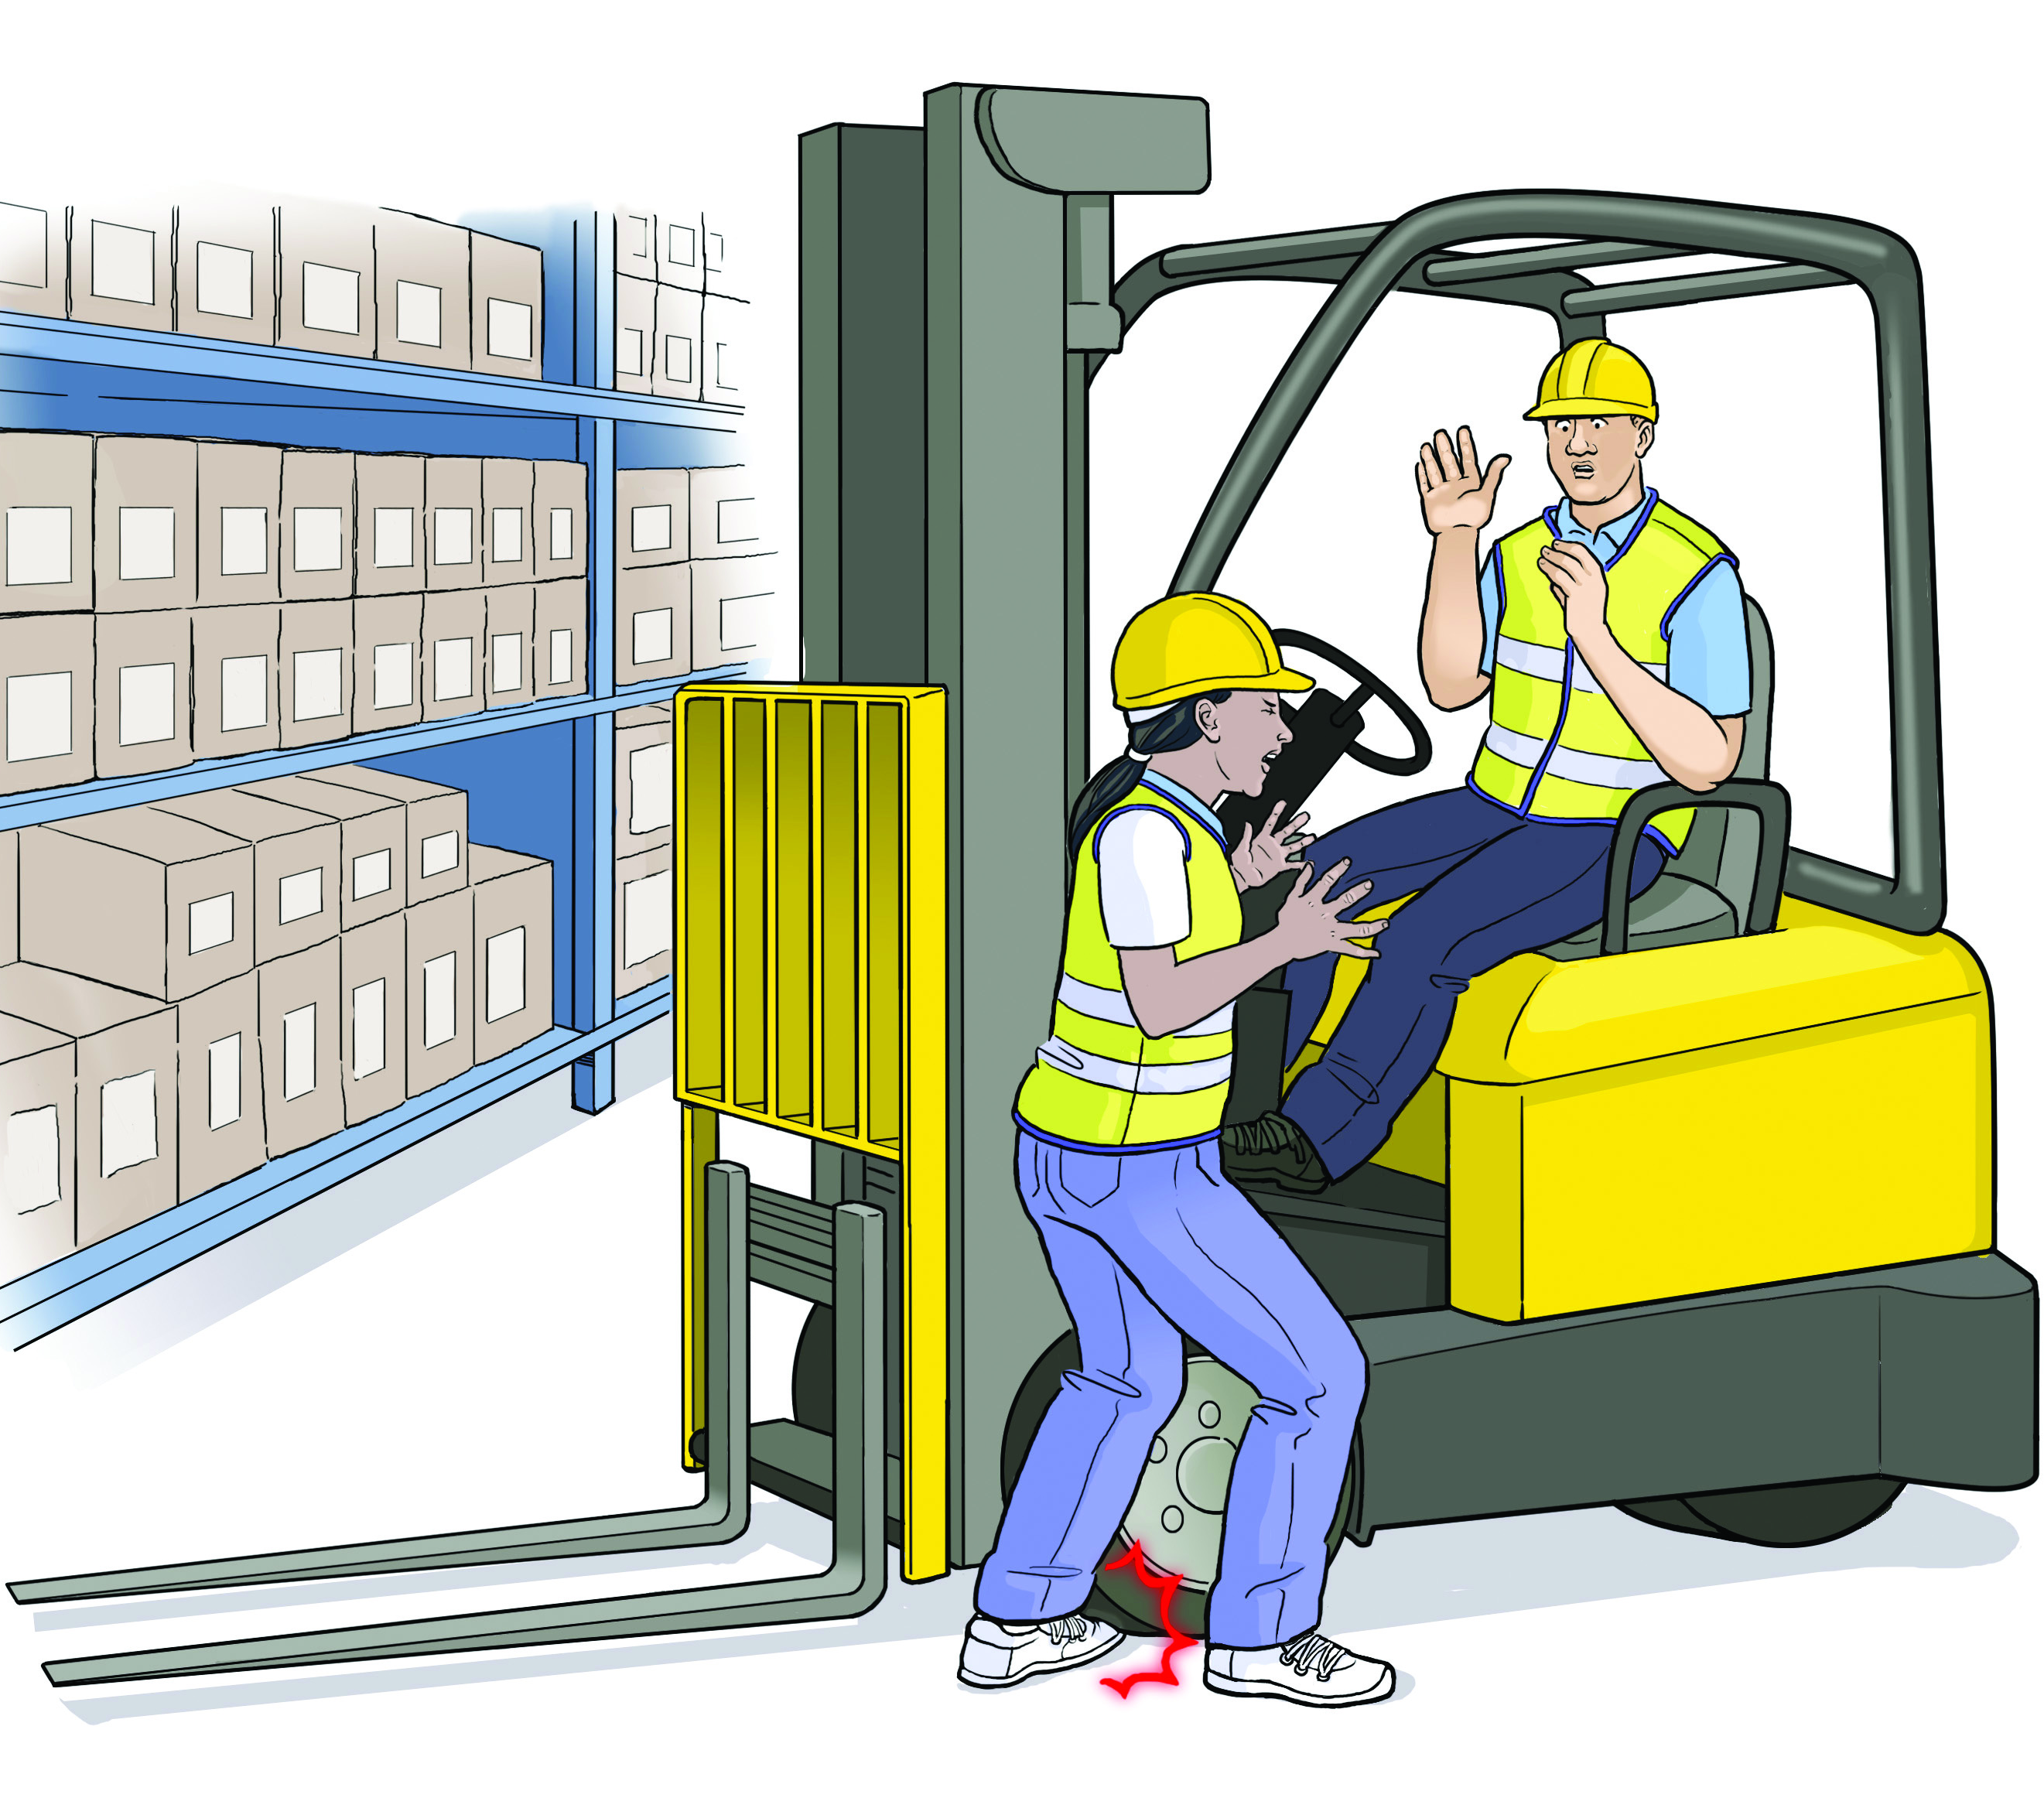
Jackie’s Story
Job: Warehouse logistics
Injury: Foot crushed by forklift

Slide 17
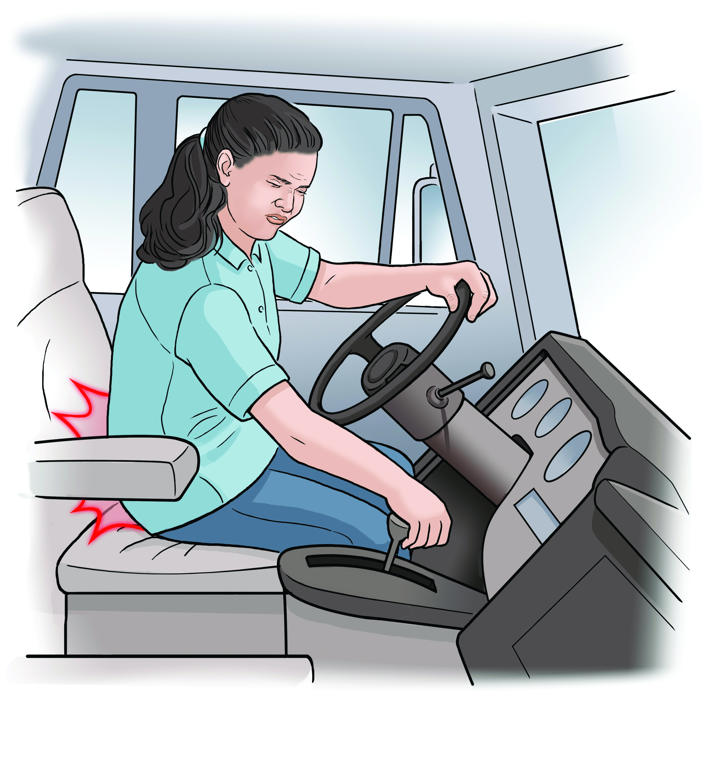
Maria’s Story
Job: Truck Driver
Injury: Back pain from driving

Slide 18
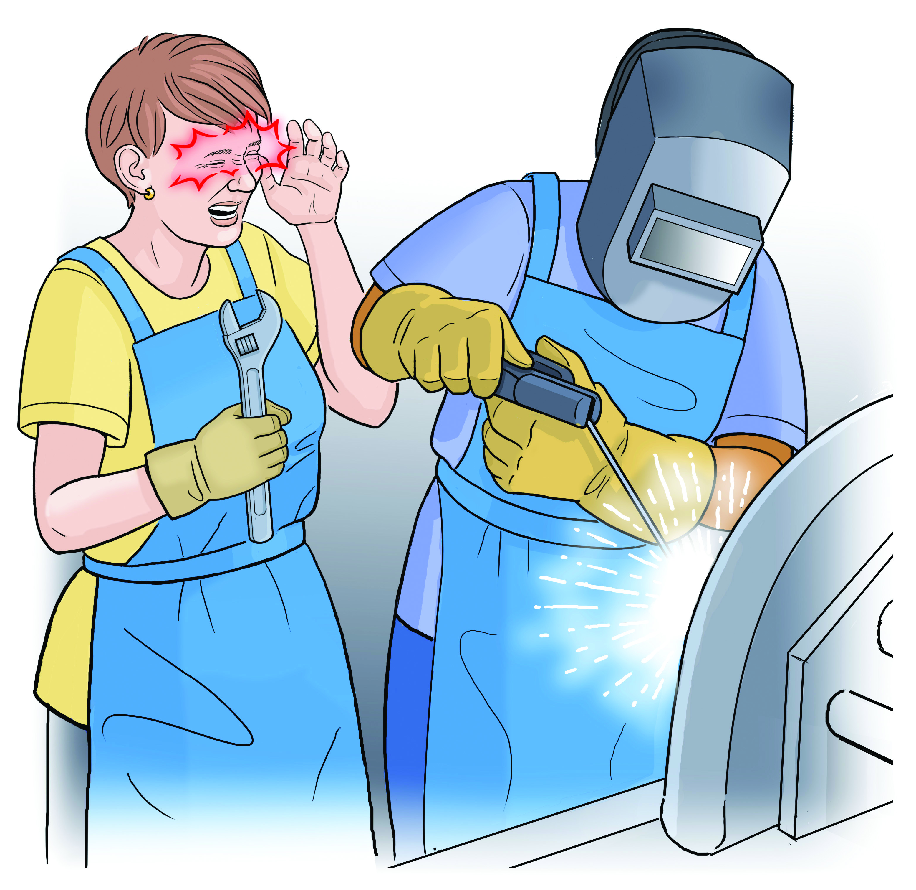
Dani’s Story
Job: Ag mechanic
Injury: Arc flash eye injury from welding

Slide 19
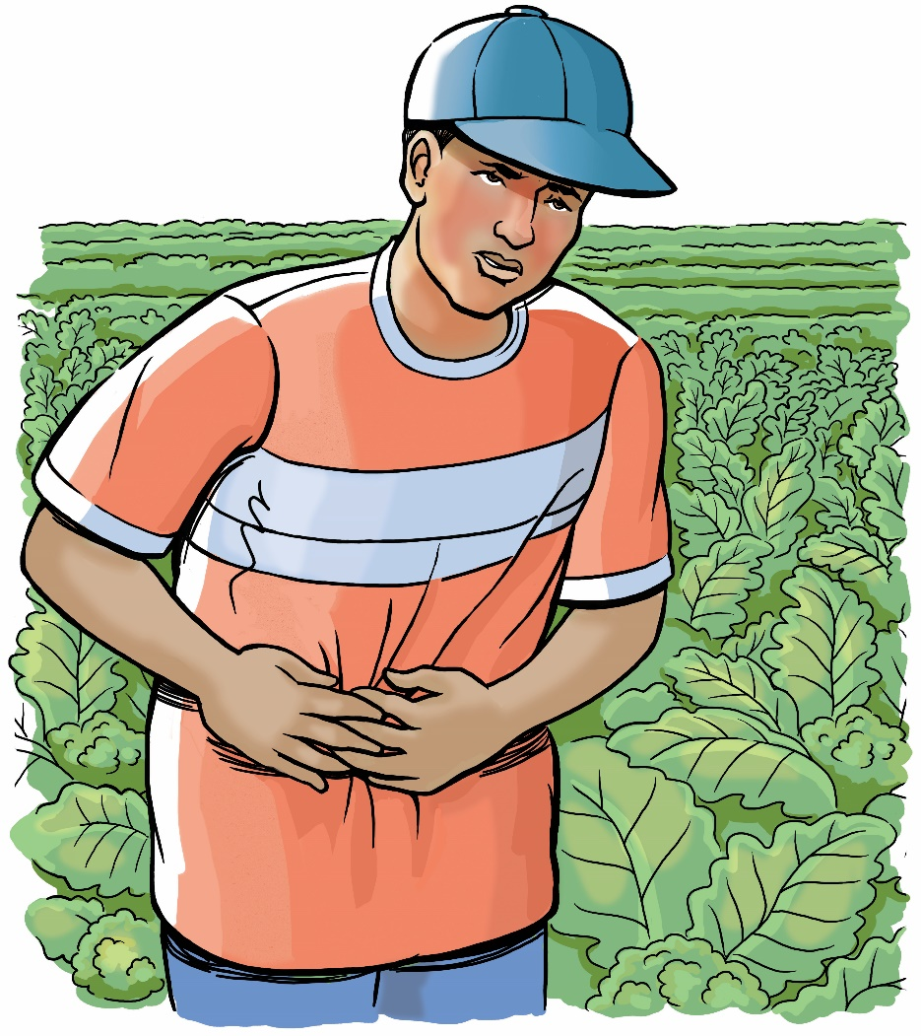
Arnaldo’s Story
Job: Agricultural worker
Injury: Pesticide poisoning

Slide 20
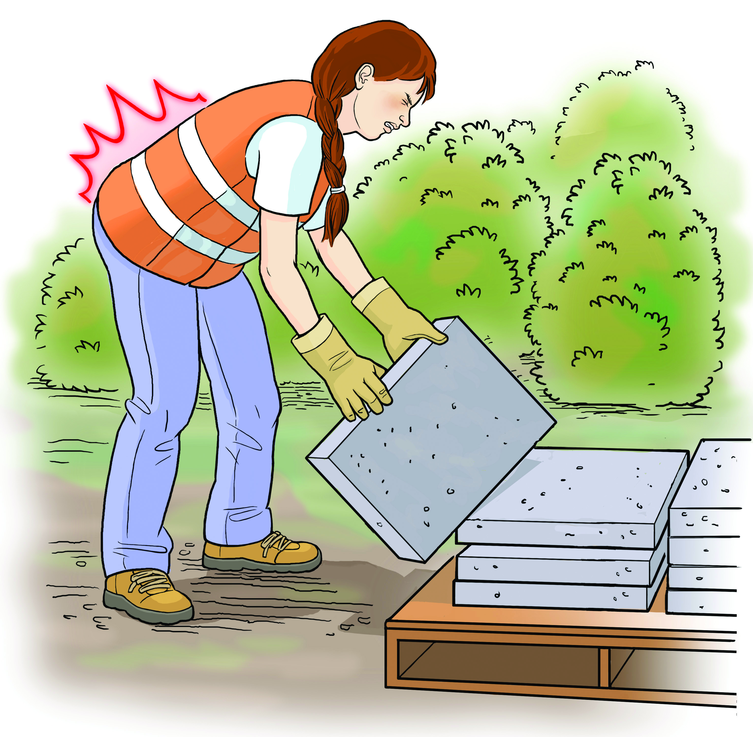
Emily’s Story
Job: Commercial landscaping
Injury: Hurt back while
laying pavers

Slide 21
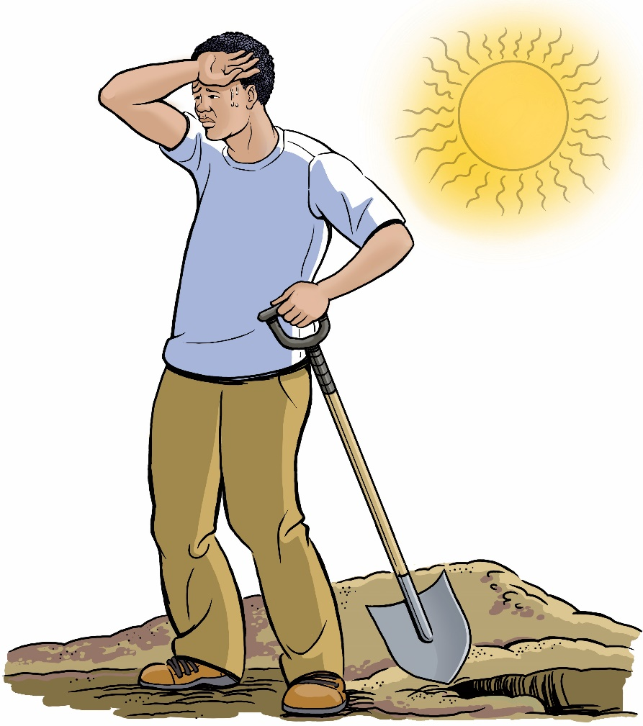
James’ Story
Job: Laborer
Injury: Died due to heat

Slide 22
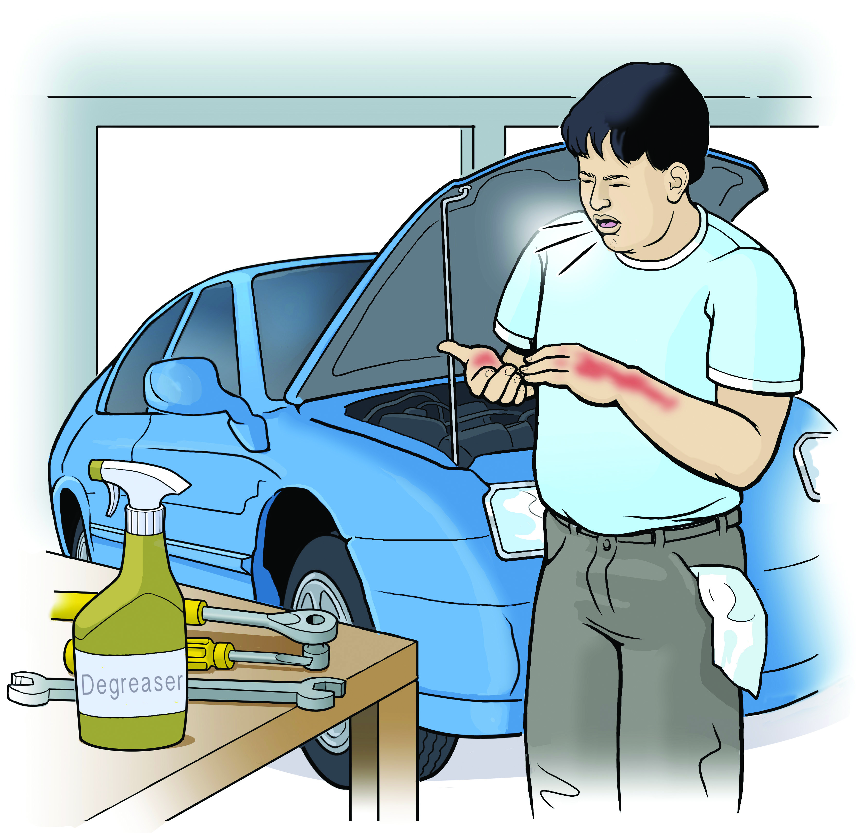
Mike’s Story
Job: Auto mechanic
Injury: Rash and breathing problems from degreaser

Slide 23
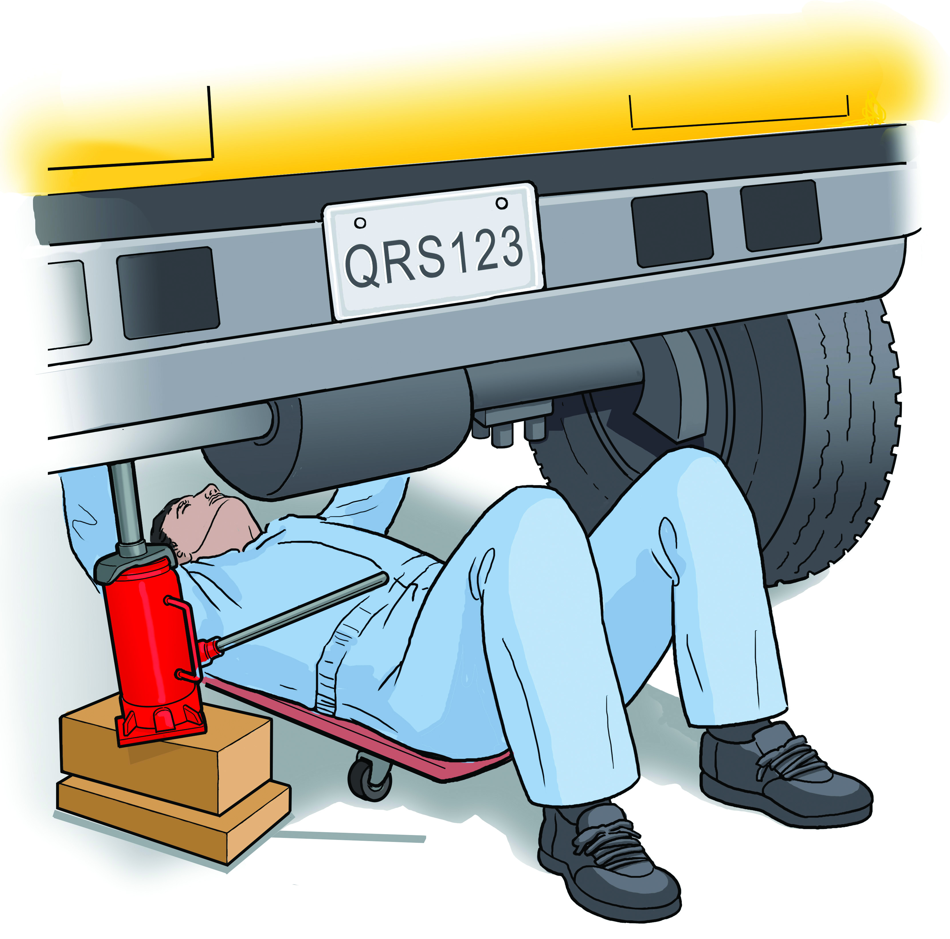
Jose’s Story
Job: Bus mechanic
Injury: Crushed under vehicle

Slide 24
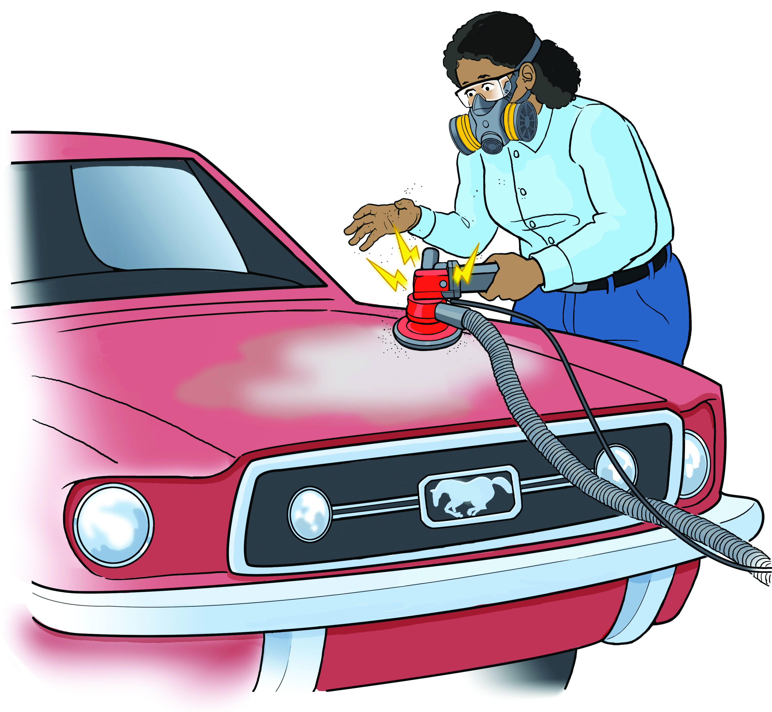
JD’s Story
Job: Auto body repair
Injury: Electric shock

Slide 25
Problem-Solving Skills
Asking questions
Gathering information/analyzing the problem
Being open-minded
Being self-confident
Collaborating with others

Slide 26
How to Approach a Workplace Problem
Define the problem.
Get advice from a co-worker, teacher, family member.
Choose your goals. Decide which solution is best.
Know your rights.
Decide the best way to talk to the supervisor.
If necessary, contact an outside agency (like Cal/OSHA) for help.

Slide 27
Summing It Up
Know your rights
Fact sheet?
Know your responsibilities
It’s your responsibility to follow safety rules and to report any problems you see.
Know your employer’s responsibilities
Your employer must keep the workplace safe and give you safety training
Know the steps to take to solve problems
Resources include co-workers, friends, teachers, and government agencies like Cal/OSHA

Slide 28
For More Information
LOHP, UC Berkeley Resource Center:
Website: www.lohp.org
Facebook: www.facebook.com/LaborOccupationalHealthProgram/
(510) 642-5507
Occupational Health Branch, CDPH
Website: https://www.cdph.ca.gov/OHB
(510) 620-5757
Contacts
Diane Bush, dbush@berkeley.edu
Laura Stock, lstock@berkeley.edu

