Slide 2
Prepared by:
U.C. Berkeley Labor Occupational Health Program (LOHP)
Adapted from the following curricula:
Youth @ Work—Talking Safety. A Safety and Health Curriculum for Young Workers. 2013
Department of Health and Human Services,
Centers for Disease Control and Prevention,
National Institute for Occupational Safety and Health
OSHA’s 11. An OSHA 10-hour curriculum for Young Workers. 2009
University of Washington-Pacific Northwest OSHA Education Center
UC Berkeley Labor Occupational Health Program
Education Development Center, Inc.
This activity guide includes instructor’s notes and training materials for teaching youth basic job health and safety knowledge and skills. Activities in this guide cover how to recognize and reduce hazards in the workplace, employees’ rights and responsibilities, and how to speak up about workplace concerns in an effective manner. The Guide was developed by LOHP, UC Berkeley. These materials are part of the Young Worker Partnership which is administered by the Commission on Health and Safety and Workers' Compensation in the Department of Industrial Relations.

Slide 3
Are You A Working Teen?
Game Show
This activity was adapted from Youth @ Work: Talking Safety

Slide 4
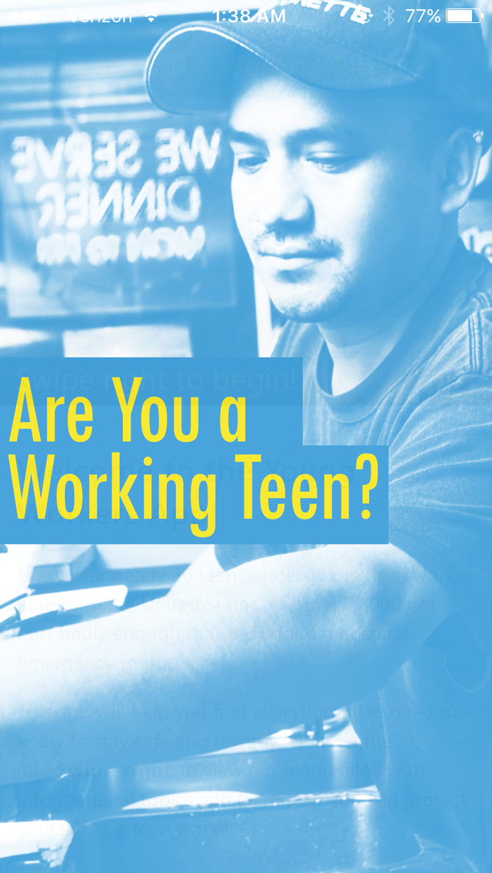
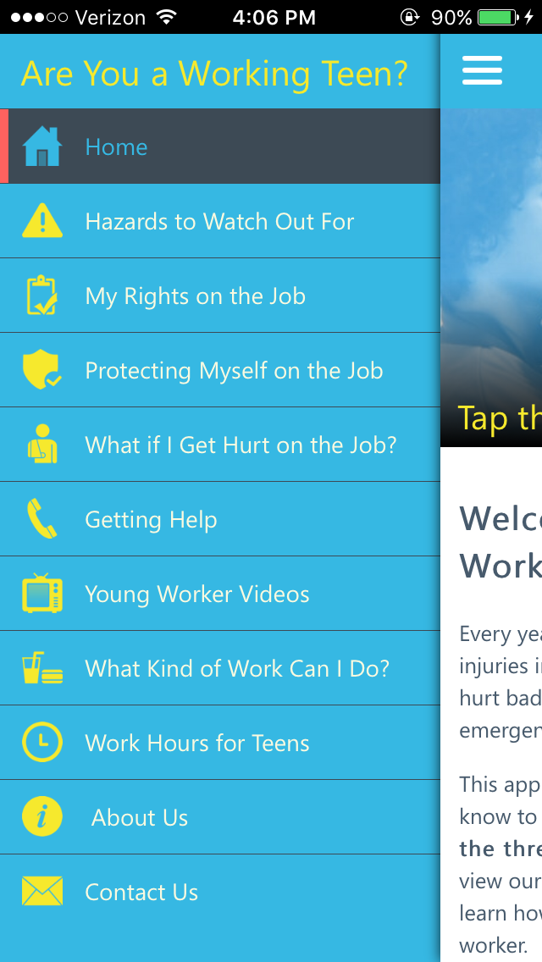
Download
the app

Slide 5
Rules
The first team will pick a category and dollar amount from the game board. The teacher will ask the question for that place on the game board.
The team gets approximately 30 seconds to discuss the question and come up with an answer.
If the first team answers correctly, they get the dollar amount for the question. The scorekeeper will record it in the column on the flipchart for that team.
After a question has been answered, cross off the block on the game board poster. If using the Power Point, this will happen automatically.
If the first team answers incorrectly, the next team in order will be called on to answer the same question. This will continue until a team gets the correct answer. They win the dollar amount. There is no penalty for incorrect answers. If all teams miss a question, the instructor will give the correct answer.
Once one question is completed, the next team picks a category and dollar amount (even if they just answered a bonus question).

Slide 6
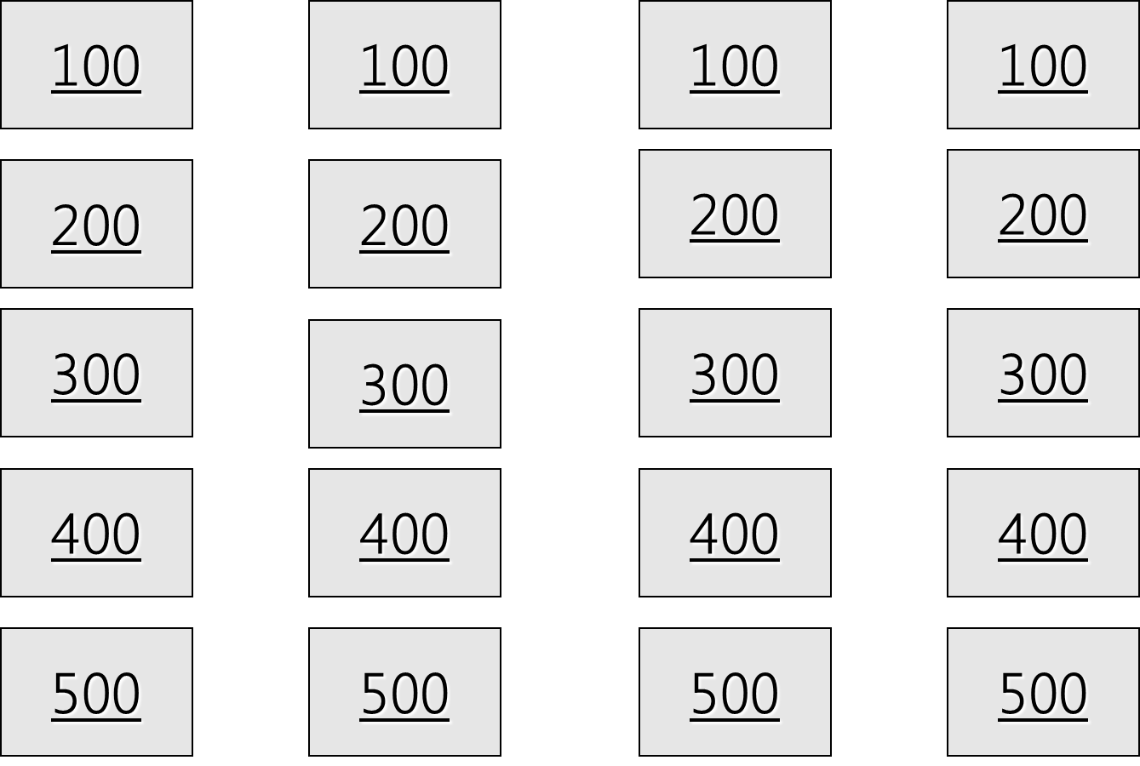
My Rights on the Job
What Kind of Work Can I Do?
Hours for Teens & Protecting Myself
What If I Get Hurt & Getting Help
100
100
100
100
200
200
200
200
300
300
300
300
400
400
400
400
500
500
500
500

Slide 7
True.
True or False?
Your employer can’t punish
you for reporting a
safety problem.
Home
Row 1, Col 1

Slide 8
18 years old.
How old do you have to be
to drive a forklift?
Home
Row 1, Col 2

Slide 9
3 hours.
If you are 14 or 15, how many
hours can you work
on a school day?
Home
Row 1, Col 3

Slide 10
False.
True or False? You can
sue your employer if
you’re hurt on the job?
Home
Row 1, Col 4

Slide 11
$15.50 an hour.
What’s the minimum wage in
California?
Home
Row 2, Col 1

Slide 12
Power equipment (meat slicer, saw, bakery machine, box crusher).
Name one kind of machinery
you can’t use if you’re under 18.
Home
Row 2, Col 2

Slide 13
7 pm.
If you are 14 or 15, how late
can you work on
a school night?
Home
Row 2, Col 3

Slide 14
False, it is against the law for your boss to punish or fire you for a job-related injury
True or False? Your boss can
punish you for getting
hurt on the job.
Home
Row 2, Col 4

Slide 15
Payment of medical care, You may also get lost wages
Name two rights you have if you
get hurt on the job.
Home
Row 3, Col 1

Slide 16
A work permit.
If you’re under 18 and still
in school, what do you need
to get before you take a job?
Home
Row 3, Col 2

Slide 17
18 hours.
If you’re 14 or 15, how many
hours can you work in a
school week?
Home
Row 3, Col 3

Slide 18
Cal/OSHA.
What’s the name of the
state agency that handles
health and safety complaints?
Home
Row 4, Col 4

Slide 19
A safe and healthy workplace, Safety training,
Protective clothing,
Name two health
and safety protections
your employer must provide
on the job.
Home
Row 4, Col 1

Slide 20
Baking, dry cleaning/laundry, using ladder or scaffold, construction, loading and unloading trucks, rail cars, or conveyors.
Name one kind of work you
can’t do if you’re 14 or 15
(but 16 & 17 year olds can do.)
Home
Row 4, Col 2

Slide 21
10 p.m.
If you are 16 or 17, how late
can you work on a school
night?
Home
Row 4, Col 3

Slide 22
Division of Labor Standards Enforcement
What agency enforces the
laws about work hours
and wages in California?
Home
Row 3, Col 4

Slide 23
To report safety problems, to work without racial or sexual harassment, to join a union.
Name two rights all workers
have on the job.
Home
Row 5, Col 1

Slide 24
Wrecking, demolition, excavation, or roofing.
Name one kind of construction
work you can’t do if you
are under 18.
Home
Row 5, Col 2

Slide 25
Report unsafe conditions, get safety training, follow safety rules.
Name two things you can
do to prevent a
job injury.
Home
Row 5, Col 3

Slide 26
Tell your boss, get medical treatment, fill out a claim form.
Name two things you should
do if you get hurt
on the job.
Home
Row 5, Col 4

Slide 27
$25,000
Safety Pyramid Game
This activity was adapted from Youth @ Work: Talking Safety

Slide 28
Controlling Hazards
a
Remove
the Hazard
$2000
(for example, use safer
chemicals, use a machine guard)
Improve Work
Policies & Procedures
$1000
(for example, conduct training,
assign enough people to do the job)
Wear Personal Protective Equipment (PPE)
$500
(for example, wear gloves, use a respirator)

Slide 29
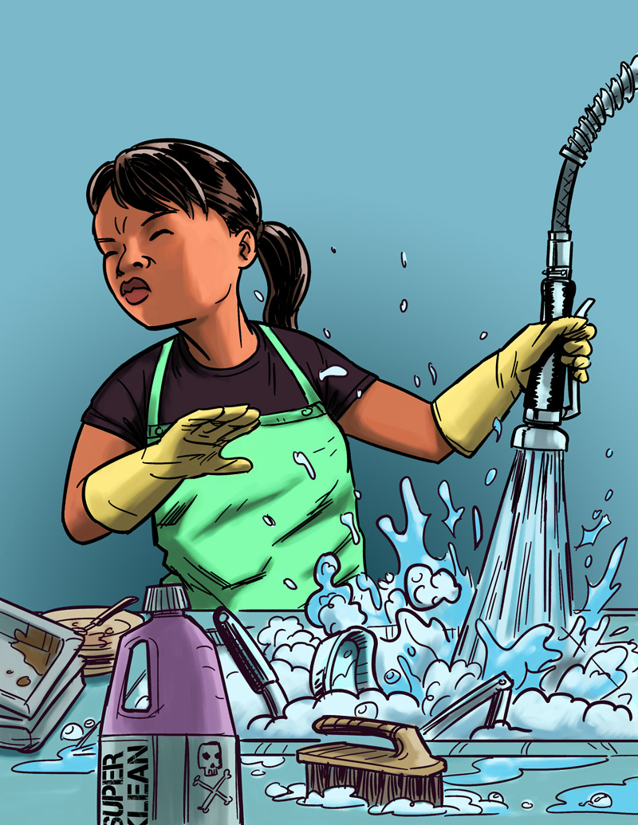
Eliminating or Reducing Hazards
Jasmin’s Story
Job: Hospital dishwasher
Hazard: Chemical dishwashing solution
Injury: Chemical burn to the eye
$25,000 Safety Pyramid Game

Slide 30
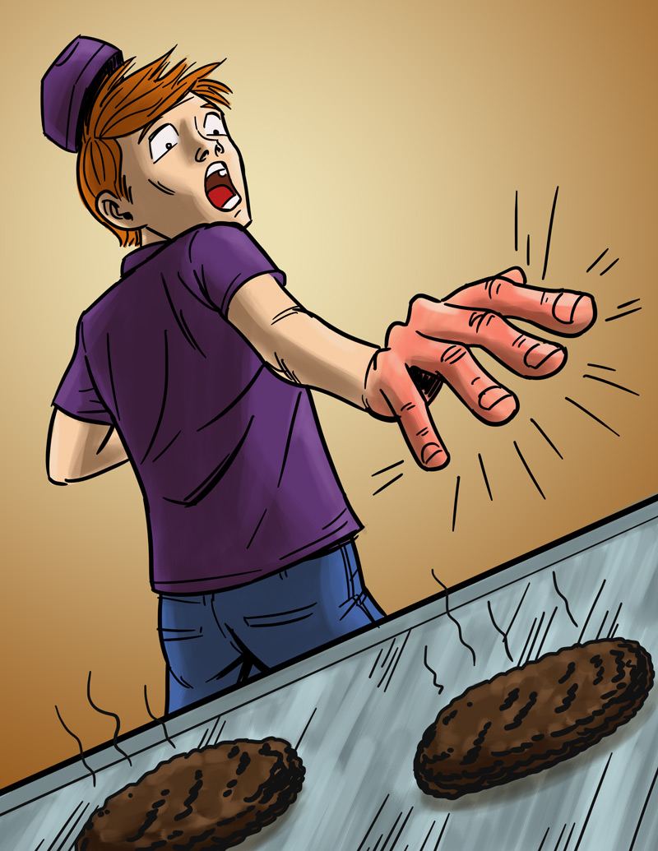
Eliminating or Reducing Hazards
Will’s Story
Job: Fast food worker
Hazard: Hot grill
Injury: Burned hand
$25,000 Safety Pyramid Game

Slide 31
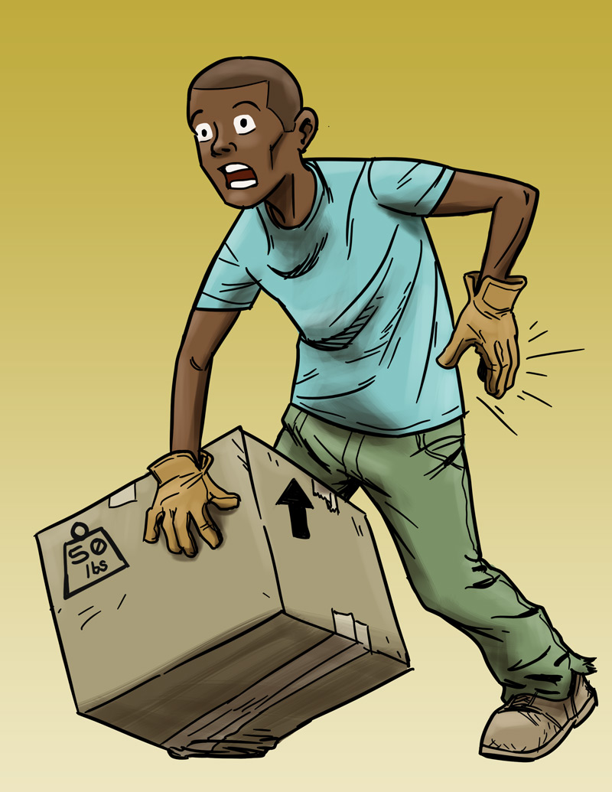
Eliminating or Reducing Hazards
Andre’s Story
Job: Grocery store clerk
Hazard: Lifting heavy boxes
Injury: Back strain
$25,000 Safety Pyramid Game

Slide 32
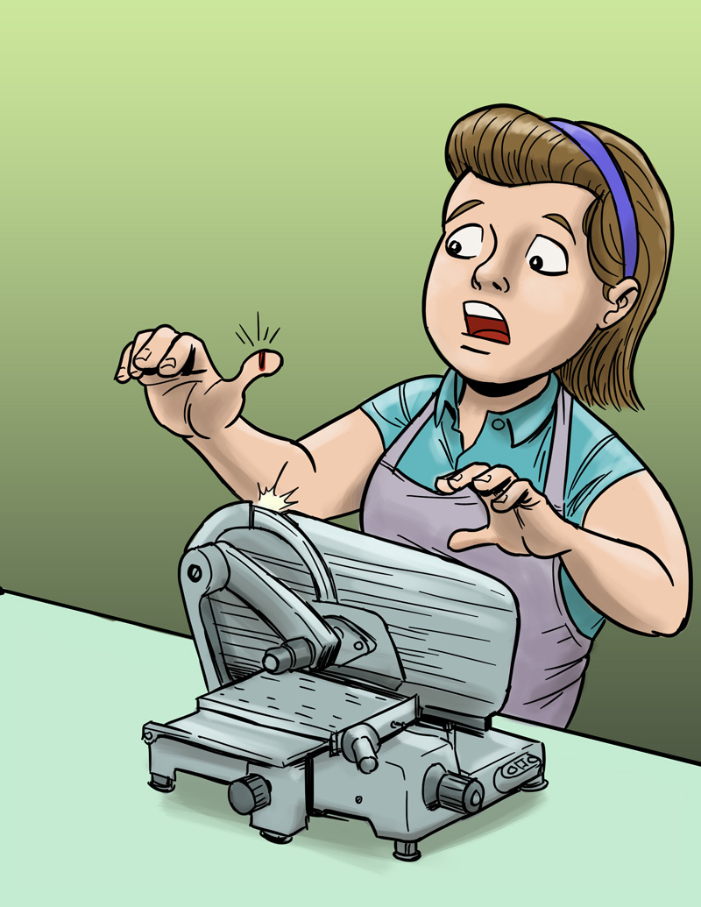
Eliminating or Reducing Hazards
Molly’s Story
Job: Grocery store deli clerk
Hazard: Meat slicer
Injury: Cut finger
$25,000 Safety Pyramid Game

Slide 33
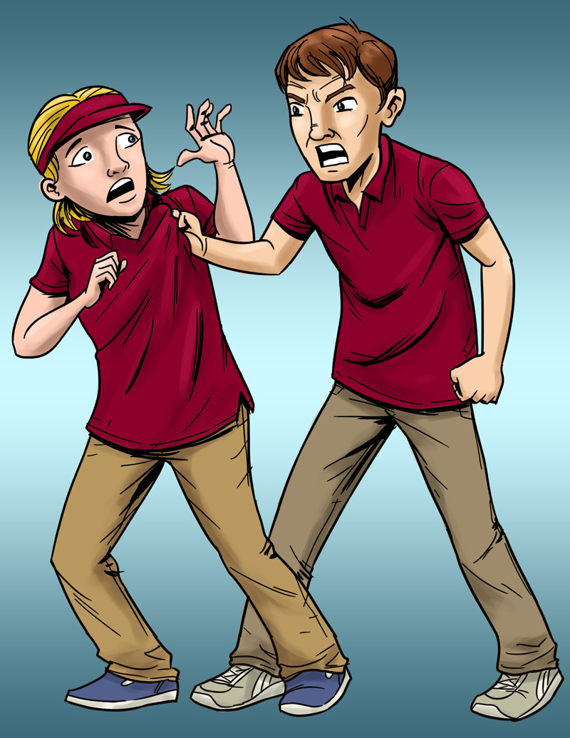
Eliminating or Reducing Hazards
Lindsey’s Story
Job: Pizza shop cashier
Hazard: Violence (by a co-worker)
Injury: Bumps and bruises caused by abusive co-worker
$25,000 Safety Pyramid Game

Slide 34
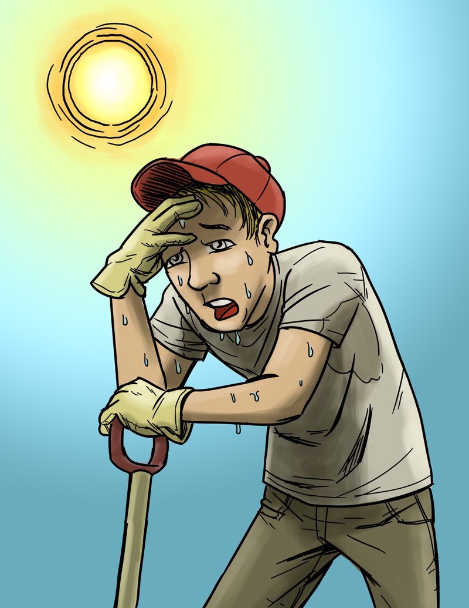
Eliminating or Reducing Hazards
Chris’s Story
Job: City public works employee
Hazard: Excessive heat
Injury: Heat stroke
$25,000 Safety Pyramid Game

Slide 35
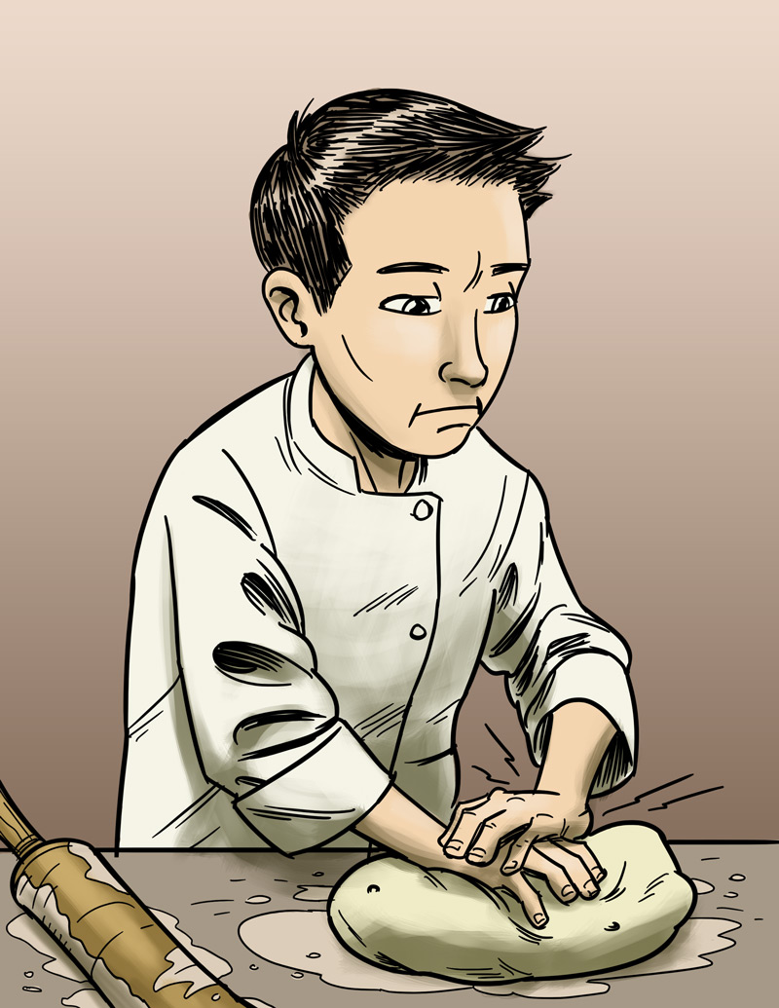
Eliminating or Reducing Hazards
James’s Story
Job: Pizza shop employee
Hazard: Repetitive motion
Injury: Hand, back injury
$25,000 Safety Pyramid Game

Slide 36
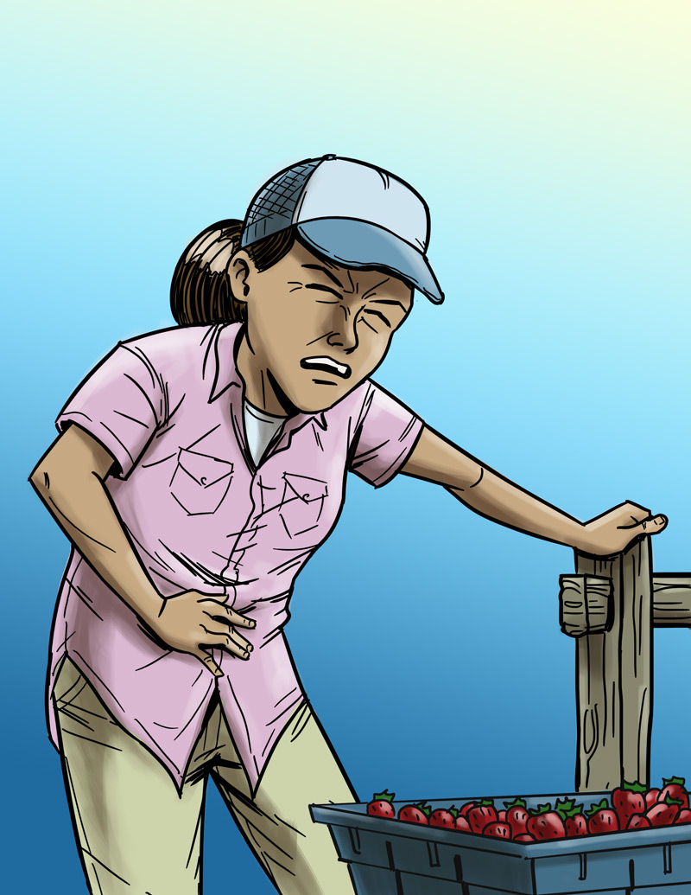
Eliminating or Reducing Hazards
Maria’s Story
Job: Farm worker
Hazard: Pesticide/chemical exposure
Injury: Illness due to poisoning
$25,000 Safety Pyramid Game

Slide 37
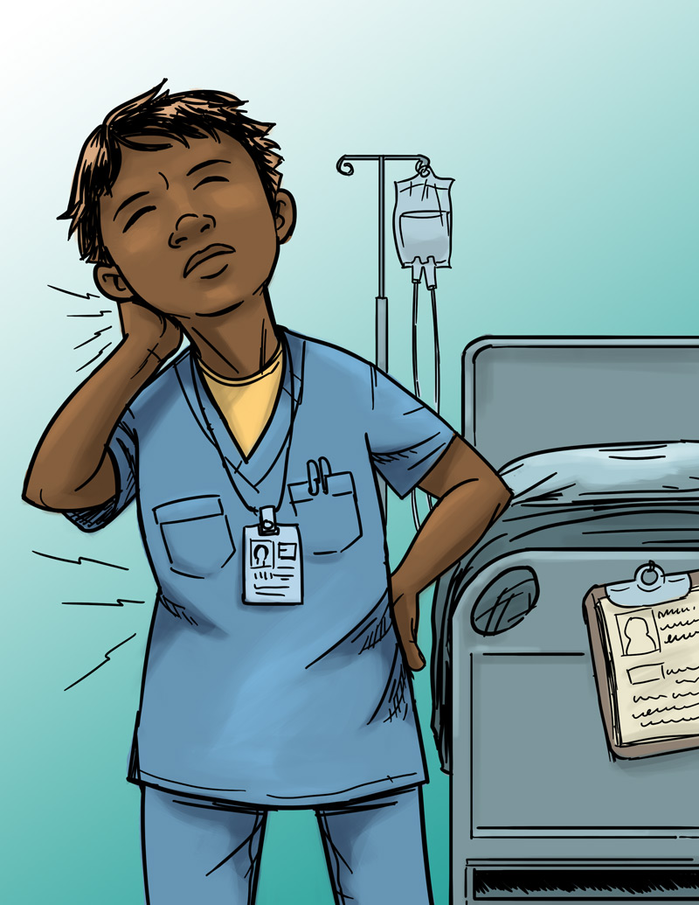
Eliminating or Reducing Hazards
Jada’s Story
Job: Nursing aide
Hazard: Heavy lifting
Injury: Back, neck, and shoulder pain
$25,000 Safety Pyramid Game

Slide 38
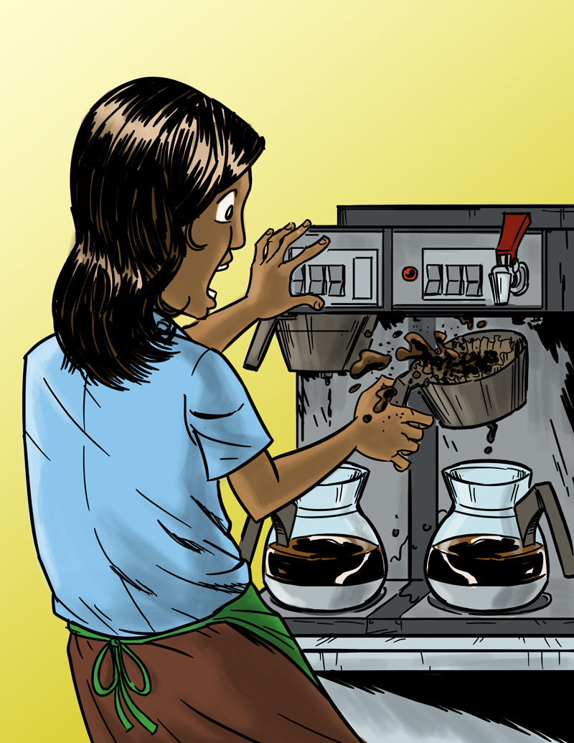
Eliminating or Reducing Hazards
Anita’s Story
Job: Barista
Hazard: Hot liquids
Injury: Burn
$25,000 Safety Pyramid Game

