Slide 1

Safe Jobs for Youth

Slide 2
Prepared by:
U.C. Berkeley Labor Occupational Health Program (LOHP)
Adapted from the following curricula:
Youth @ Work—Talking Safety. A Safety and Health Curriculum for Young Workers. 2013
Department of Health and Human Services,
Centers for Disease Control and Prevention,
National Institute for Occupational Safety and Health
OSHA’s 11. An OSHA 10-hour curriculum for Young Workers. 2009
University of Washington-Pacific Northwest OSHA Education Center
UC Berkeley Labor Occupational Health Program
Education Development Center, Inc.
This activity guide includes instructor’s notes and training materials for teaching youth basic job health and safety knowledge and skills. Activities in this guide cover how to recognize and reduce hazards in the workplace, employees’ rights and responsibilities, and how to speak up about workplace concerns in an effective manner. The Guide was developed by LOHP, UC Berkeley. These materials are part of the Young Worker Partnership which is administered by the Commission on Health and Safety and Workers' Compensation in the Department of Industrial Relations.

Slide 3
Game Show
Are You A Working Teen?
This activity was adapted from Youth @ Work: Talking Safety

Slide 4
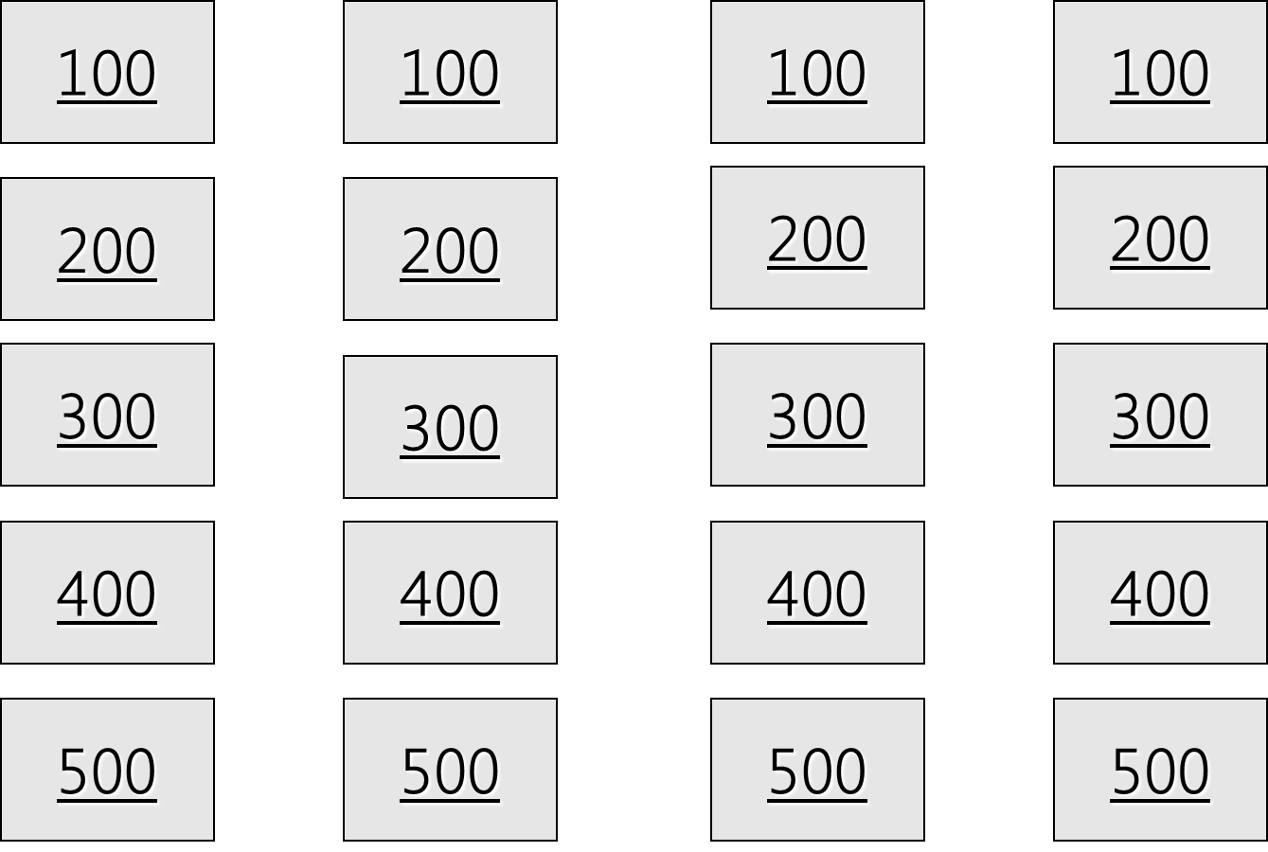
Jeopardy Game
My Rights on the Job
What Kind of Work Can I Do?
Hours for Teens & Protecting Myself
What If I Get Hurt & Getting Help
100
100
100
100
200
200
200
200
300
300
300
300
400
400
400
400
500
500
500
500

Slide 5
True.
True or False?
Your employer can’t punish
you for reporting a
safety problem.
Home
Row 1, Col 1

Slide 6
How old do you have to be
to drive a forklift?
18 years old.
Home
Row 1, Col 2

Slide 7
3 hours.
If you are 14 or 15, how many
hours can you work
on a school day?
Home
Row 1, Col 3

Slide 8
False.
True or False? You can
sue your employer if
you’re hurt on the job?
Home
Row 1, Col 4

Slide 9
Jeopardy Game, 2
$16.50 an hour.
What’s the minimum wage in
California?
Home
Row 2, Col 1

Slide 10
Power equipment (meat slicer, saw, bakery machine, box crusher).
Name one kind of machinery
you can’t use if you’re under 18.
Home
Row 2, Col 2

Slide 11
Row 2, Col 3
7 pm.
If you are 14 or 15, how late
can you work on
a school night?
Home

Slide 12
False, it is against the law for your boss to punish or fire you for a job-related injury
True or False? Your boss can
punish you for getting
hurt on the job.
Home
Row 2, Col 4

Slide 13
Payment of medical care, You may also get lost wages
Name two rights you have if you
get hurt on the job.
Home
Row 3, Col 1

Slide 14
A work permit.
If you’re under 18 and still
in school, what do you need
to get before you take a job?
Home
Row 3, Col 2

Slide 15
Row 3, Col 3
18 hours.
If you’re 14 or 15, how many
hours can you work in a
school week?
Home

Slide 16
Cal/OSHA.
What’s the name of the
state agency that handles
health and safety complaints?
Home
Row 4, Col 4

Slide 17
Row 4, Col 1
A safe and healthy workplace, Safety training,
Protective clothing,
Name two health
and safety protections
your employer must provide
on the job.
Home

Slide 18
Baking, dry cleaning/laundry, using ladder or scaffold, construction, loading and unloading trucks, rail cars, or conveyors.
Name one kind of work you
can’t do if you’re 14 or 15
(but 16 & 17 year olds can do.)
Home
Row 4, Col 2

Slide 19
Row 4, Col 3
10 p.m.
If you are 16 or 17, how late
can you work on a school
night?
Home

Slide 20
Division of Labor Standards Enforcement/Labor Commissioners Office
What agency enforces the
laws about work hours
and wages in California?
Home
Row 3, Col 4

Slide 21
To report safety problems, to work without racial or sexual harassment, to join a union.
Name two rights all workers
have on the job.
Home
Row 5, Col 1

Slide 22
Wrecking, demolition, excavation, or roofing.
Name one kind of construction
work you can’t do if you
are under 18.
Home
Row 5, Col 2

Slide 23
Report unsafe conditions, get safety training, follow safety rules.
Name two things you can
do to prevent a
job injury.
Home
Row 5, Col 3

Slide 24
Tell your boss, get medical treatment, fill out a claim form.
Name two things you should
do if you get hurt
on the job.
Home
Row 5, Col 4

